Slide 1
Victorian Poetry
Intro. Class (1)

Slide 2
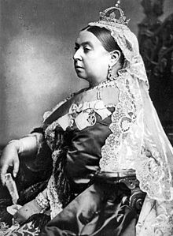

Slide 3
The Victorian era of British history was the period of Queen Victoria's reign from 20 June 1837 until her death on 22 January 1901. It was a long period of prosperity, refined sensibilities and national self-confidence for Britain. Some scholars date the beginning of the period in terms of sensibilities and political concerns to the passage of the Reform Act 1832. The era was preceded by the Georgian period and followed by the Edwardian period. The latter half of the Victorian age roughly coincided with the first portion of the Belle Époque era of continental Europe and the Gilded Age of the United States.

Slide 4
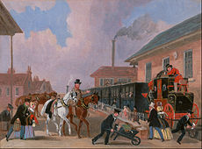
The Louth-London Royal Mail travelling by train from Peterborough East, 1845

Slide 5
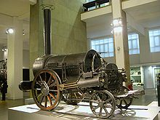
The railways changed communications and society dramatically

Slide 6
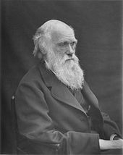
By 1878, an increasingly famous Darwin had suffered years of illness.

Slide 7
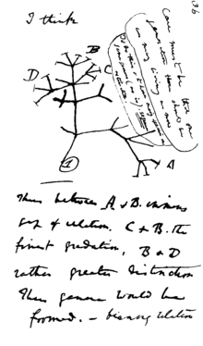
In mid-July 1837 Darwin started his "B" notebook on Transmutation of Species, and on page 36 wrote "I think" above his first evolutionary tree.

Slide 8
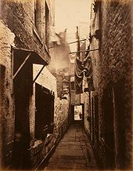
Glasgow slum in 1871

Slide 9
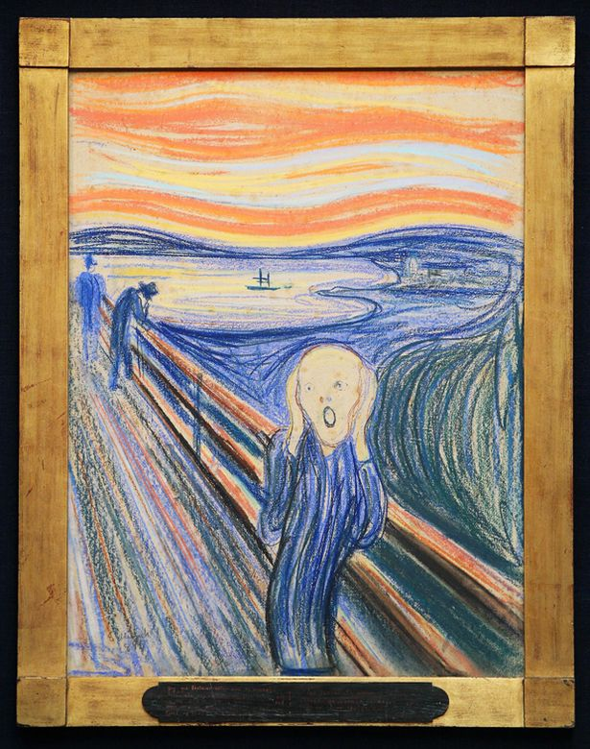

Slide 10
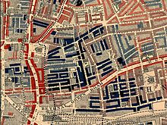
Part of Charles Booth's poverty map showing the Old Nichol, a slum in the East End of London. Published 1889 in Life and Labour of the People in London. The red areas are "middle class, well-to-do", light blue areas are "poor, 18s to 21s a week for a moderate family", dark blue areas are "very poor, casual, chronic want", and black areas are the "lowest class...occasional labourers, street sellers, loafers, criminals and semi-criminals".

Slide 11
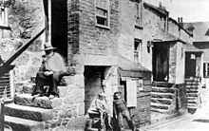
Working class life in Victorian Wetherby, West Yorkshire

Slide 12
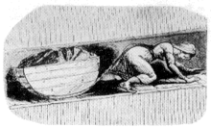
Girl pulling a coal tub in mine. From official report of the parliamentary commission in the mid 19th century.

Slide 13
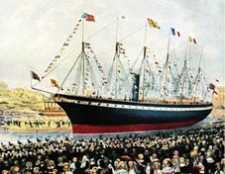
The 1843 launch of the Great Britain, the revolutionary ship of Isambard Kingdom Brunel

Slide 14
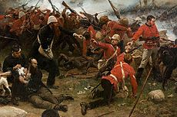
The defence of Rorke's Drift during the Anglo-Zulu War of 1879

Slide 15
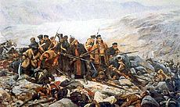
The last stand of the survivors of Her Majesty's 44th Foot at Gandamak, Afghanistan

Slide 16
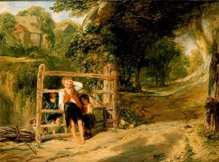
'Rustic Civility' by William Collins RA, oil on panel, England, 1833, Museum no. FA.27

Slide 17
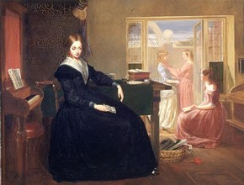
'The Governess' by Richard Redgrave RA, oil on canvas, Great Britain, 1844, Museum no. FA.168

Slide 18
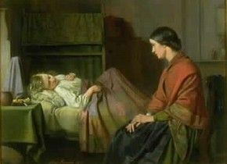
'An Anxious Hour' by Alexander Farmer, oil on panel, England, 1865, Museum no. 541-1905

Slide 19
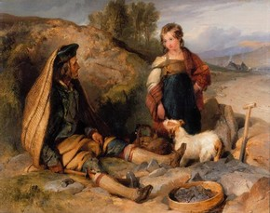
'The Stonebreaker and His Daughter' by Sir Edwin Henry Landseer RA, 1830, Museum no. 508-1882

Slide 20
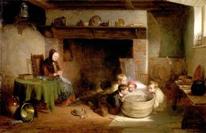
'Contrary Winds' by Thomas Webster RA, oil on panel, Great Britain, 1843, Museum no. FA.223

Slide 21
Intellectual and spiritual doubt:
Victorian poetry is self-defining: poetry written during the reign of Queen Victoria (1837-1901). But the dates of Victoria's reign also seem to mark out a consistent sensibility in poetry. Victorian poets were heirs to the Romantics, and many of the generalizations about Romantic poetry still apply: distrust of organized religion, skepticism, interest in the occult and the mysterious. Yet where Romantic poets made a leap of faith to assert that the received image of God did not exist, Victorian poets were more likely to have a scientific conviction of God's absence ("Dover Beach" by Matthew Arnold is the great Victorian example). Such brooding skepticism informs the work of Tennyson, Arnold, Robert Browning and others

Slide 22
Skepticism:
The late-Romantic / early-Victorian poet Thomas Hood is here as a transitional figure; his famous poem "I Remember, I Remember" catches a note of nostalgic regret that carries through English poetry all the way to the 1890s, and is not typical of the great energy of the "High Romantics.”

Slide 23
Growing Social Consciousness
& High Moral Tone:
Recurrent themes include childhood, the plight of women, rejected love, poverty and old age. In the Victorian period, artists and writers appealed in a very direct and emotive way to their audiences. Literature was intended to involve their audience in the way that films do today. But art and literature were not just for entertainment. Many artists, such as writers Charles Dickens and Charles Kingsley, had a reforming mission. They set out to evoke compassion and sympathy in the public and bring about a humanitarian response to the evils they saw in their society. Paintings and novels provided examples of good and bad behaviour, supplying ideal characters to be imitated and showing the grievous effects of not following society's rules.

Slide 24
Nationalism: Britain – first great modern industrial nation

