Slide 1

Ten Tips to Perfect your English

Slide 2
Define your Target!
Notes:
The reason u r studying this, define the whole processes (pleasure, business, academic purposes..etc)

Slide 3

Use a Native!
How?
Notes:
Get me (a, an, some) water:
Results: 10 too 500,000,000

Slide 4

http://scholar.google.com/ http://books.google.com/

Slide 5
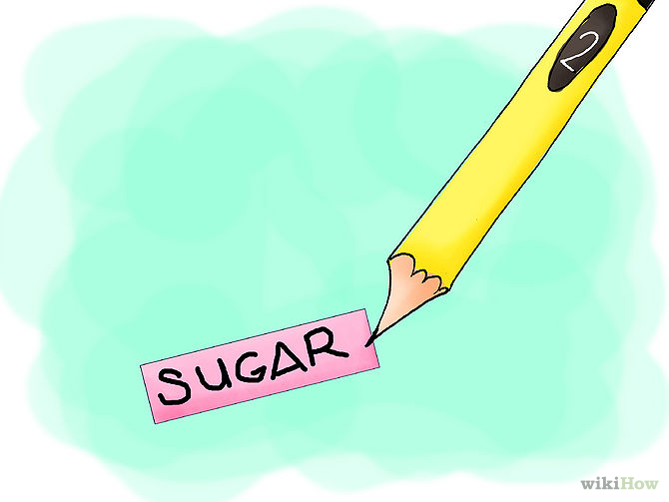
Don’t translate!
Labeling Vs Composing sentences.
Use apps: Words while Waiting
English Useful Expressions
Notes:
Use apps: Words waiting, English

Slide 6

Speak up!
The natural order is listening, speaking, reading, then writing
My ultimate goals IS to speak English.. Well, Do Not (for now)

Slide 7

Radio, Podcasts, Audio-Books, SoundCloud:
BBC World Service.
NPR.
This American Life.
The BBC World Service is just one excellent source of spoken English and even broadcasts programs for learners. Have it on in the background while you go about doing your household tasks.
Notes:
The BBC World Service is just one excellent source of spoken English and even broadcasts programs for learners. Have it on in the background while you go about doing your household tasks.

Slide 8
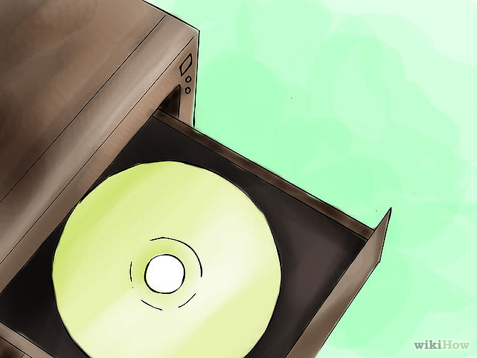
Using Technology:
. Rosetta Stone can cost a pretty penny, but it's useful. Some even offer accessibility to a native speaker!
- Pimsleur and Michel Thomas as well.

Slide 9
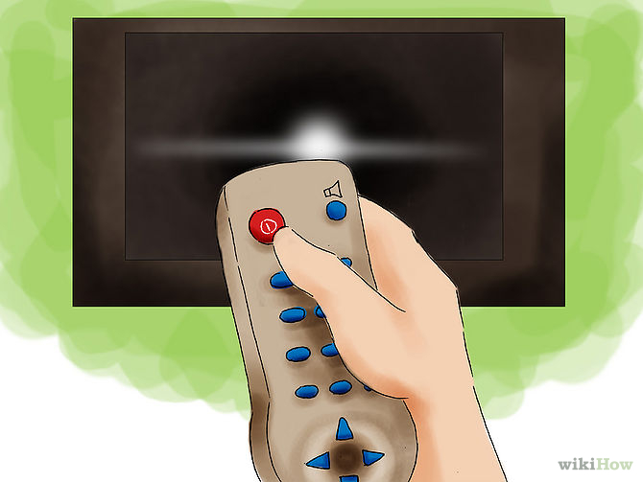
Make the best of technology & your free-time.
Thanks to satellite TV, British, American and Australian television programmes and films are widely available all over the world. Try recording them! Watch with subtitles at first and then without them as you gain confidence.

Slide 10
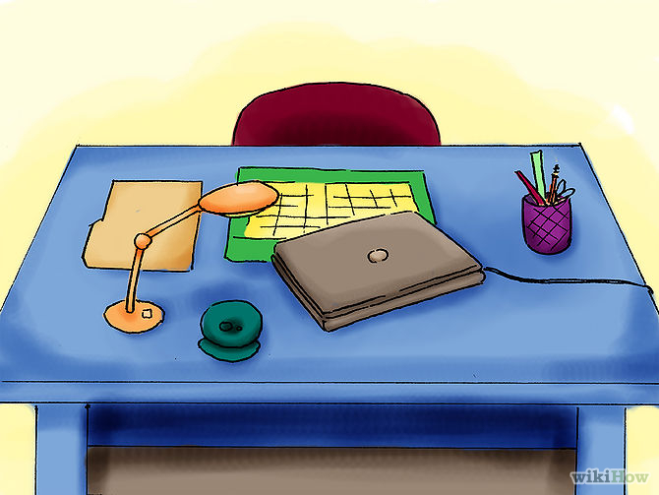

Find a tutor!
Do a language exchange
(ESL Learners)

Slide 11

What to read?!
Read children's magazines and books.
Some newspapers use more complex language than others, so choose the right one for you.

Slide 12
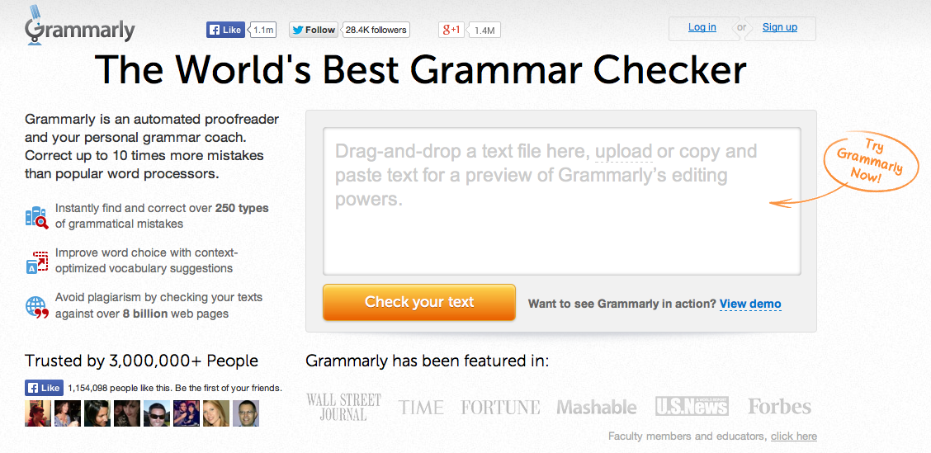
Use "correcting" websites.
Write your emails in English, write yourself notes in English, write your blog in English. Even if you can't correct it, make it habit.

Slide 13
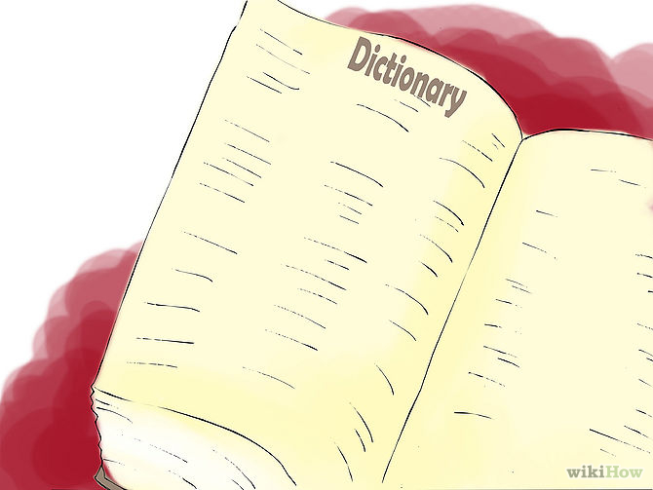
Learn root words, prefixes, and suffixes.
Let's say you run into the sentence, "It was an acephalous society." You're thinking, "Uhh...what the heck?!" But back up. Think about it for a second. You know that "a-" means without: amoral, asymmetrical. You know that "cephal" means "head": encephalitis, encephalogram. And you know that "-ous" marks an adjective: ambitious, delicious, glamorous. All of a sudden you know that that means, "It was a society without a head, without a leader." Boom!

Slide 14
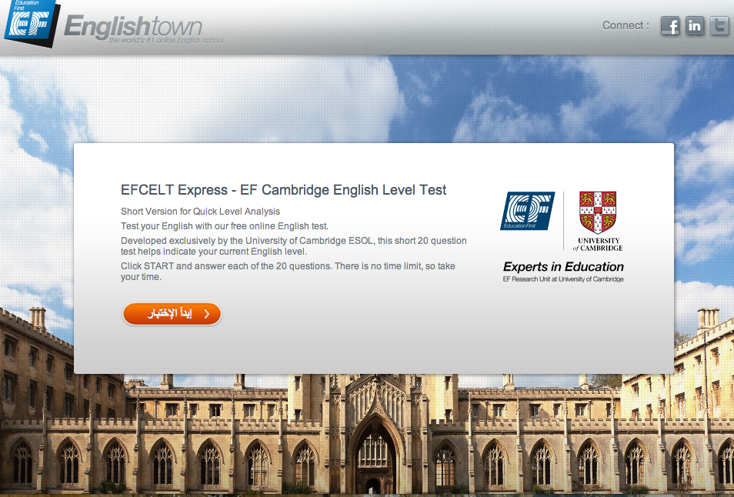
Take Tests!

Slide 15
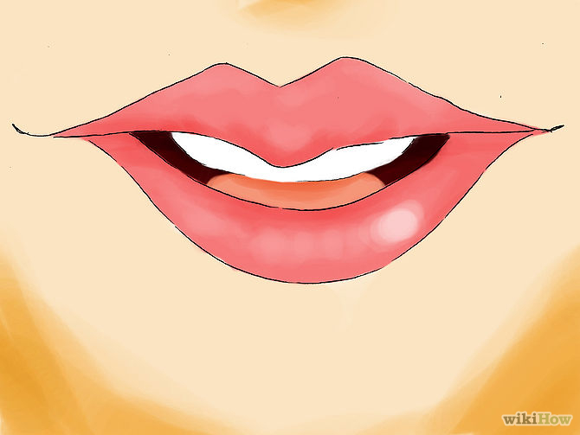
-Practice, practice, practice!
-You won’t learn without having mistakes.
-Keep learning.

Slide 16
Sources & Citations:
↑ http://www.oxforddictionaries.com/us/words/how-many-words-are-there-in-the-english-language
↑ http://www.oxforddictionaries.com/us/words/is-it-true-that-english-has-the-most-words-of-any-language
http://www.langports.com/100-things-you-can-do-to-improve-your-english/
http://www.perfect-english-grammar.com/english-writing.html
http://www.i-studentglobal.com/learning-english/10-ways-to-improve-your-english
http://www.bbc.co.uk/blogs/learningenglish/2012/09/how-to-improve-your-english.shtml

Slide 17

Quiz:

Slide 18
The End
Thanks for your attendance everybody!

