Slide 1
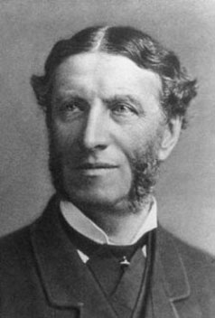
MATTHEW ARNOLD

Slide 2
      Matthew Arnold was born in Middlesex Country (December 24,1822) entered the school (Winchester) officially the first time Matthew then moved in 1837 to Rugby school, which was run by his father and where he stayed until the end of his secondary education in 1840

Slide 3
Literary Biography
Literary Biography; Matthew Arnold entered the University of oxford in 1841, after receiving a grant from the open that University, and in 1845 was named a fellow of the Arnold of the teaching staff of the Faculty of the University of Oxford Orel. Matthew Arnold took over the post of Professor of Poetry at Oxford University(1857-1867) as well as its inspector general for school.

Slide 4
The Most Important Writings
                Two strings, which are carrying the same title<<articles in exchange>> (the first edition of theme in 1865, and the second in 1888).

Slide 5
Lengthy article “st. Paul and Protestantism
Literature and Dogma
God and The Bible
Last Essays on Church and Religion

Slide 6
(The Future)
9
A WANDERER is man from his birth .
He was born in a ship
On the breast of the river of Time;
Brimming with wonder and joy
He spreads out his arms to the light;
Rivets his gaze on the banks of the stream.
As what he sees is, so have his thoughts been.
Whether he wakes,
Where the snowy mountainous pass ,

Slide 7
Echoing the screams of the eagles,
Hems in its gorges the bed
Of the new-born clear-flowing stream;
Whether he first sees light
Where the river in gleaming rings
Sluggishly winds through the plain;
Whether in sound of the swallowing sea-
As is the world on the banks,
So is the mind of the man.

Slide 8
Vainly does each , as he glides,
Fable and bream
Of the lands which the river of Time
Had left ere he woke on its breast,
Or shall reach when his eyes have been closed
Only the tract where he sails
He wots of; only the thoughts,
Raised by the objects he passes, are his.

Slide 9
These lines are taken from Matthew Arnold’s poem ‘’The Future’’ It was written in the
Victorian era.
There are many Victorian glimpses throughout poem .first, there is a sense of spiritaelo doupt, for example, ‘’A WANDERER is man from his birth /He was born in a ship ’’
[1:2]. Second , there is a sense of realism , for example, “As what he sees is, so have his thoughts been.’’[7] .third , there is skepticism ,for example ,’’ As what he sees is, so have his thoughts been.’’[19].

Slide 10
Figure of speech
There are many stylistic devices in the poem. first ,there is metaphor for example, ‘’river” (3). Secnd, there is a Alliteration for example, “Born – brith”(2).third, there is anaphora for example, “Stream – stream” (6:12).

