Slide 1

The
Wonderful
World
of
Literary Theory:
Shine a Light on Literature

Slide 2
The
Modes
(well, the major ones…
Reader Response
Formalist
Deconstructionist
Psychological
Gender
Historical
Biographical
Cultural
Mythological
Sociological
the
ones
you
should
know)
•
•
•
•
•
•
•
•
•
•

Slide 3
Myriad
Approaches
•
Important: No single theory is necessarily
correct or true above any other
Critical approaches usually derive from personal discretion or applicability
Some approaches naturally lend themselves to particular works
•
•

Slide 4
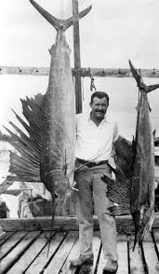
For
example…
•
Any work by Hemingway
would naturally lend itself to a biographical approach, because most of his stories are either literally or figuratively based on his experiences.

Slide 5
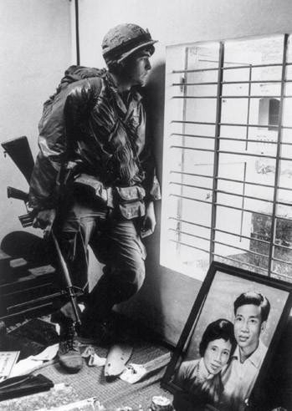
Another
It would be tough
to talk about Tim
O’Brien’s The
Things They
Carried without
understanding the
historical
context…
example…
•

Slide 6
Reader
Response
Theory
•
Attempts to describe what happens in a
reader’s mind when interpreting a text
Recognizes plurality of texts
Explores contradictions inherent in the problem this approach presents
•
•

Slide 7
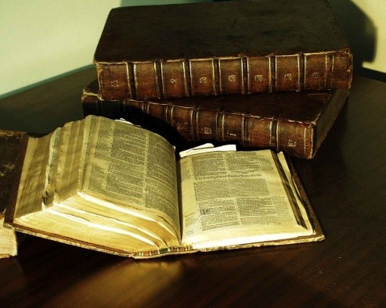
Formalist
Criticism
•
Regards literature as a unique form of human
knowledge to be regarded in its own terms
Apart from or above biographical, social, historical, or cultural influences
Literature is understood through its intrinsic literary features
TEXT-CENTERED: focus on words
•
•
•

Slide 8
Formalist
“Close Reading”
cont’d…
•
•
•
•
Focus on intense relationships in a work
Form and content cannot be meaningfully separated
Interdependence of form and content make a text literary

Slide 9
Biographical
Criticism
•
Considers that literature is written by actual
people
Understanding of author’s life helps comprehend the work
Author’s experience SHAPES the creation of the work
Practical advantage: illuminates text
Be judicious--base interpretation on what is in the text itself (Cheever, Plath, Fitzgerald examples)
•
•
•
•

Slide 10
Historical
Criticism
•
Investigation of social, cultural, and
intellectual contexts that produced the
work
•
Necessarily includes author’s biography and
look at the world in which they lived
a
•
Impact and meaning on original audience
(as opposed to today’s)
How a text’s meaning has changed over time
•
•
Connotations of words, images (1940, America)

Slide 11
Psychological
Criticism
•
Owes much to the work of Sigmund Freud
•
Painful memories (esp. from childhood)
repressed, stored in subconscious
Freud and followers (including Carl Jung) believed that great literature truthfully reflects life
•

Slide 12
Psychological
Three approaches
cont’d…
•
1.
Creative process of the arts
•
What is genius and how is it related to mental
functions?
How does a work impact the mind of the reader?
•
2.
3.
Psychological study of artist
Analysis of fictional characters
•
•
Freud’s analysis of Oedipus is the prototype
Attempt to apply modern insights to fictional people
psych criticism seeks to DELVE
•
All

Slide 13
Mythological
Criticism
•
•
Seeks recurrent universal patterns
Combines insights
disciplines:
of
many
•
•
•
•
Anthropology
Psychology
History
Comparative religion

Slide 14
Mythological cont’d…
Explores artist’s common humanity (as opposed to individual emphasis in pysch. crit.)
THE ARCHETYPE
•
•
•
A symbol, character, situation, or image that evokes
deep universal response
Carl Jung (Swiss psychologist)--lifetime student of myth and religion
a
•
•
•
“collective unconscious”
Set of primal memories common to the human race
(existing below conscious mind)
Archetypal images (like sun, moon, fire, night, blood)
trigger the “collective unconscious”
•
•
Important to link text to other texts with
similar or related archetypal situations

Slide 15
Sociological Criticism
Examines literature in the cultural, economic, and political context in which
•
it
•
•
is written or received
Art not created in a vacuum
Relationship between author and society
•
•
•
Social status of author
Social content of a work (values presented) Role of audience in shaping literature

Slide 16
Sociological cont’d…
Marxist criticism
•
•
•
•
Economic and political elements of art
Explores ideological content of literature
Content determines form; therefore all art political
is
•
DANGER: imposing critic’s politics on work in
question can sway evaluation based on how
closely (or not) the work endorses ideology
VALUE: illuminates political and economic dimensions of literature that other approaches may overlook
•

Slide 17
Gender
Criticism
•
Examines how gender identity influences
the creation and reception of literary
works
Began with feminist movement
•
•
Influenced by sociology, psychology, and
anthropology
Feminist critics see a world saturated with
“male-produced” assumptions
Seek to correct imbalance by battling patriarchal attitudes
•
•

Slide 18
Gender
cont’d…
•
Feminist criticism analyzes how an
author’s gender influences ideas
Also, how gender identity influences reader
•
•
Reader sees text through eyes of his or her
gender
•
Examination of social forces responsible
for gender inequality

Slide 19
Gender
Gender criticism original feminist
cont’d…
expands beyond perspective
•
•
•
Different sexual orientations
Men’s movement
•
Not rejection of feminism, but a
contemporary rediscovery of masculinity

Slide 20
Deconstructionist Criticism
(don’t worry, I don’t really understand this one myself)
•
Rejects traditional assumption that
language can accurately represent reality
•
•
Language fundamentally unstable
Literary texts, therefore, have no fixed meaning
•
“Signs” cannot coincide with what is
“signified”
•
i.e., the actual expression ≠ what’s being
expressed

Slide 21
Deconstructionist cont’d..
Attention shifts from what is being said to how language is being used in a text
Paradox: Deconstructionist criticism often resembles formalist
•
•
•
Both involve close reading
•
BUT: decon. critics break text down into
mutually irreconcilable positions

Slide 22
Deconstructionist
cont’d..
•
REJECTION of idea that authors control
language
•
Roland Barthes and Michel Foucault call for
the “death of the author”
•
No author, no matter how brilliant, can fully
control the meaning of a text
They have also called for death of literature as a special category of writing
•
•
Merely words on a page; all texts equally untrustworthy
Therefore, literature deserves no status as art
•
•
No truths; only rival interpretations

Slide 23
Cultural
Studies
•
Relatively recent interdisciplinary field
of academic study (not solely associated
with literary texts)
Not a study of fixed, aesthetic objects
(poems, paintings), but of DYNAMIC
SOCIAL PROCESSES
•
•
Challenge: to identify and understand the
complex forms and effects of the process of
culture

Slide 24
Cultural
Studies
cont’d…
•
DEEPLY anti-formalist (remember, formalist
looks at the text in isolation)
•
Investigates complex relationship among history,
politics, and literature
Rejects notion that literature exists in an aesthetic realm separate from ethical and political categories
•
•
Views literary analysis as a means of
furthering social justice
Examines issues of race, class, and gender
•

Slide 25
Credits
Kennedy, X.J. and Gioia, D., eds. Literature: An Introduction to
•
Fiction, Poetry, and Drama.
Eighth
edition. New York: Longman, 2002.
All images courtesy of Google
Images
•

