Slide 1


SE2148 Ways of Reading
Seminar Week 1, 31/1/2020

Slide 2
Zainab Alqublan alqublanz@Cardiff.ac.uk

Slide 3
My Rule

Slide 4
What is expected from you?

Slide 5
You are the center of the module.
Read
Keep notes
Discuss exercises

Slide 6
Why do I need to study this module?
New perspective.
Inevitable exercise.

Slide 7
What are the ways of reading?

Slide 8
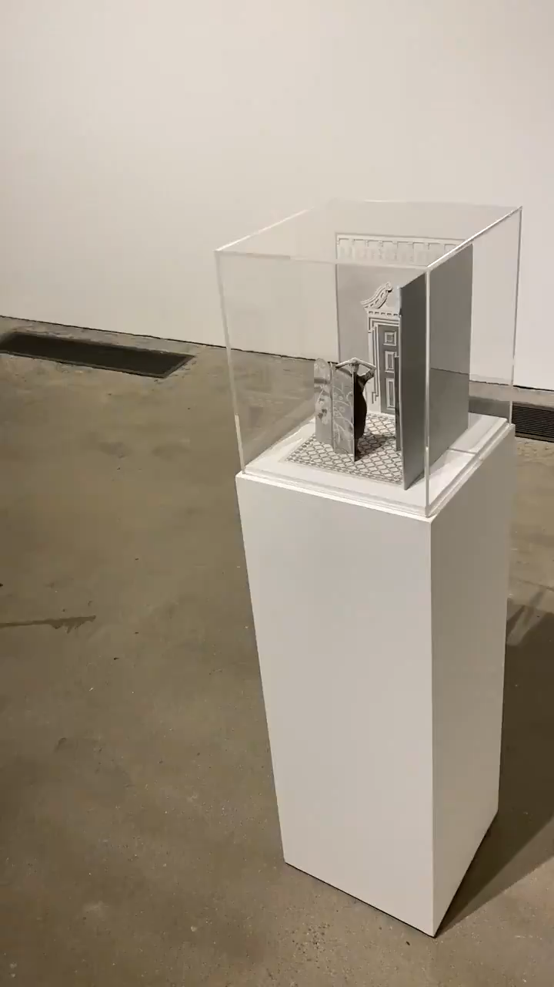

Slide 9


