Slide 1
Get to know Romantic Poetry

Slide 2
Essential Background:
Concept-Factors- Characteristics-Impact

Slide 3
Romanticism (or the Romantic era/Period) was an artistic, literary, and intellectual movement that originated in Europe toward the end of the 18th century and in most areas was at its peak in the approximate period from 1800 to 1840.

Slide 4
Reasons behind it
Partly a reaction to the Industrial Revolution
It was also a revolt against aristocratic social and political norms of the Age of Enlightenment
It was a reaction against the scientific rationalization of nature.

Slide 5
Its impact:
It was embodied most strongly in the visual arts, music, and literature, but had a major impact on historiography, education and the natural sciences.
Its effect on politics was considerable and complex; while for much of the peak Romantic period it was associated with liberalism and radicalism, in the long term its effect on the growth of nationalism was probably more significant.

Slide 6
Its characteristics
In literature, Romanticism found recurrent themes in the evocation or criticism of the past
the cult of "sensibility”
emphasis on women and children
the heroic isolation of the artist or narrator,
respect for a new, wilder, untrammeled and "pure" nature. Furthermore, several romantic authors, such as Edgar Allan Poe and Nathaniel Hawthorne, based their writings on the supernatural/occult and human psychology.

Slide 7
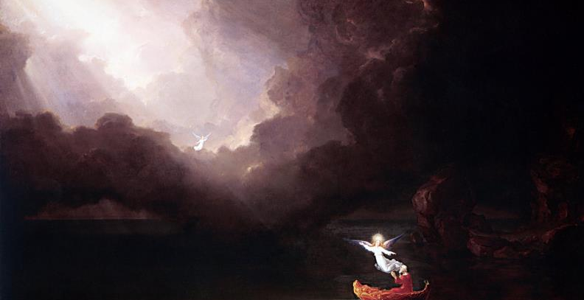
Cole_Thomas_The_Voyage_of_Life_Old_Age_1842.

Slide 8
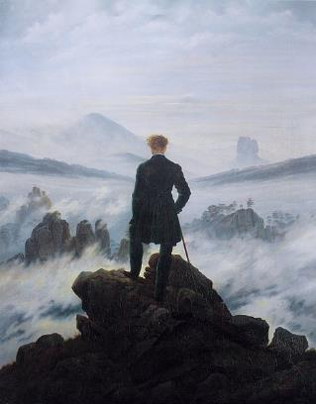
Caspar David Friedrich
The wanderer above the sea of fog

Slide 9
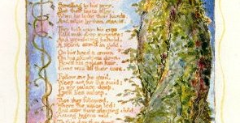
Blake The Girl Found

Slide 10
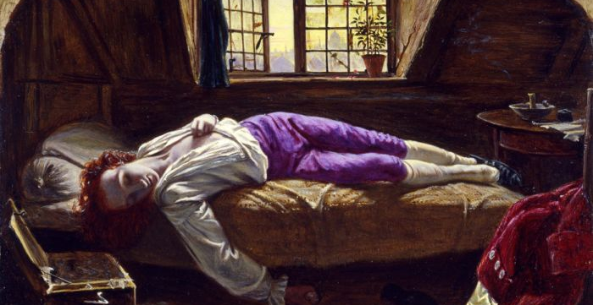
Henry Wallis-The Death of Chatterton

Slide 11
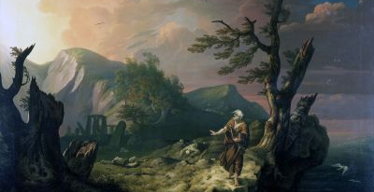
The Bard, 1774, by Welsh artist Thomas Jones.

Slide 12
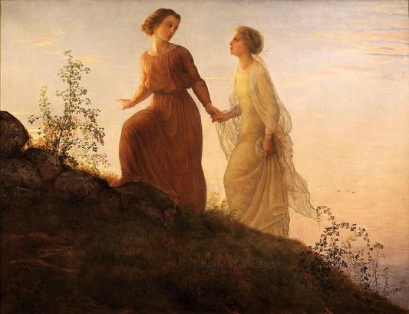
Louis Janmot-Poem of the Soul (On the Mountain)

