Slide 1
Example Script for Presenter
LOGO
Part 1: Before Presenting the Content
Good morning, ladies and gentlemen Assalamualaikum wr.wb.
It’s an honor for me today to stand in front of you to deliver a presentation.
The topic of my presentation is….(topic/title)... As we know that …(background)…
Hopefully, the presentation will .....(objective)......... In this presentation, I will cover three main points, first… second… and third…
So that would be the overall structure of my presentation, and now let’s move on to the first point.
Greeting
Topic
Background
Objective Outlining
Conclusion
Presentation time
First, I would like to talk about ......
..........................PRESENTING THE CONTENT ..........

Slide 2
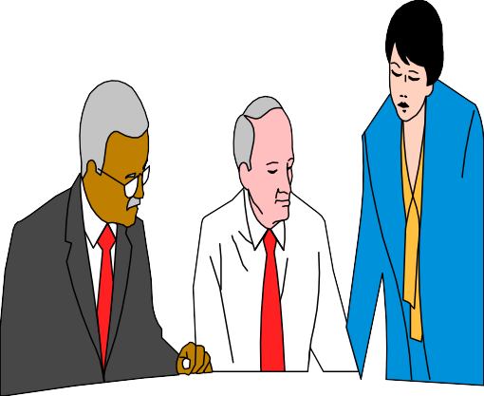

Part 2: After Presenting the Content
LOGO
Signaling an end
Ladies and Gentlemen, I think that’s the end of my talk today.
To sum up, there are .....main points, first ....., second ....and third......
Summarizing
Thank you for your attention Assalamu’alaikum wr.wb.
Closing
For More Practice,
ADE JOHAN,S.Pd. M.Pd.
a_djohan@yahoo.com

