Slide 1
How to Start a Presentation

Slide 2
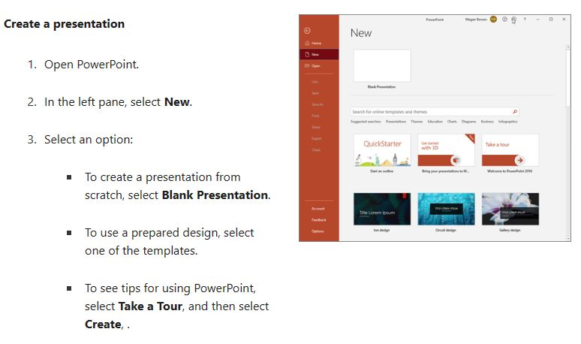

Slide 3
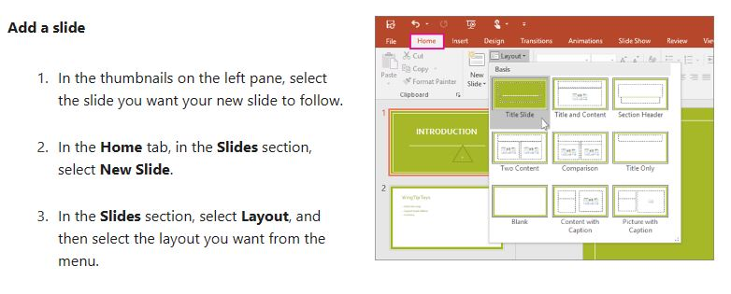

Slide 4
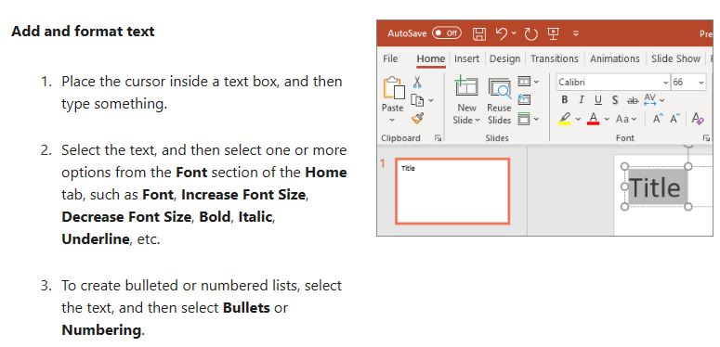

Slide 5
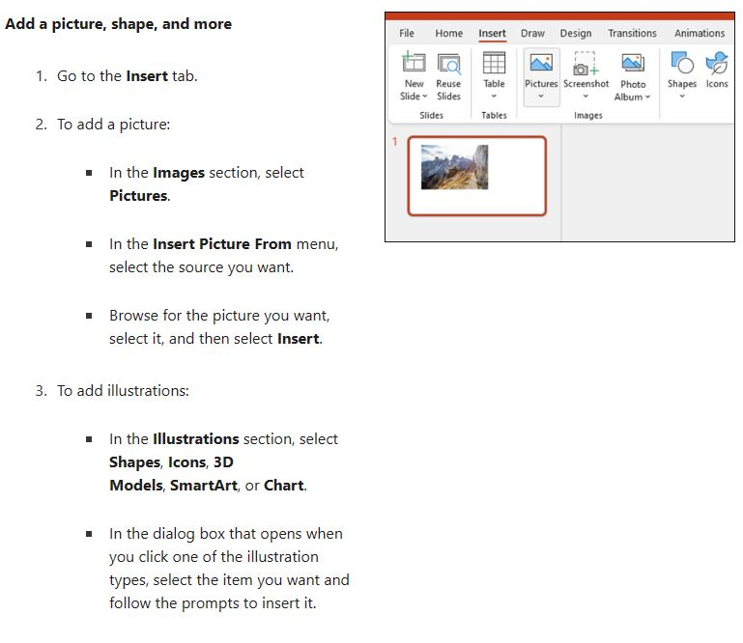

Slide 6
Start with a Question:
Example: "By a show of hands, how many of you have ever felt overwhelmed by the amount of
information you have to process daily? Well, today, we're going to explore strategies to manage
that information overload efficiently."
Quote a Significant Figure:
Example: "Albert Einstein once said, 'The only source of knowledge is experience.
' Today, we dive into the experiences that led to the groundbreaking discoveries in renewable
energy technologies."
Share a Surprising Statistic:
Example: "Did you know that every year, the world generates 2.01 billion tonnes of solid waste?
Today, we'll discuss innovative waste management technologies that can significantly reduce this number."
Tell a Relevant Anecdote or Short Story:
Example: "Let me tell you a story about a small town that revolutionized its energy consumption,
paving the way for a global movement towards sustainable living. This town is not only a model for
green energy but the heart of our discussion today."

Slide 7
Pose a Provocative Scenario:
Example: "Imagine a world where every piece of plastic ever created still exists.
Now, what if I told you that reality is not far from our current situation? Today's talk is
about tackling this enduring impact of plastic."
State Your Thesis or Purpose Upfront:
Example: "Today, I am here to argue that blockchain technology represents the next
major revolution in cybersecurity. We will explore its potential impacts, benefits, and the
challenges we face in its implementation."
Use a Prop or Visual Aid:
Example: [Holding up a small, intricate device] "This device may fit in the palm of my hand,
but its impact on medical diagnostics is enormous. Let's explore how such small tools are
making big waves in healthcare."
Ask the Audience to Visualize Something:
Example: "I want you to picture the last forest you visited. The peace, the sounds, the fresh air.
Now, imagine it gone. Today, we discuss deforestation's devastating impacts and what we can
do to prevent that loss."

Slide 8
One of the best ways to start a presentation about yourself is to start with a premade presentation template designed for PowerPoint. The benefit of working with an about me PowerPoint template is that you don’t have to start from scratch. This means you'll be able to create your about me professional presentation much faster.
PowerPoint templates come with various slide designs that you can use to share information. Just customize the design with your text and your choice of colors and fonts.

Slide 9
In her 2010 World Championship of Public Speaking speech, Lisa Panarello starts her speech with a You-focused question to capture audience attention.
“What do you want to be when you grow up?”
This is a question that everyone has heard at some point in their life, so the question immediately connects with listeners. So, how can you apply this to your presentations? How do you find questions which will connect with your audience? When you’re sharing your expertise, think about what challenge or problem your audience members are facing. For example, if you’ve been called upon to share money-management tips, the problem your audience members might be facing is that they might be struggling financially. So you might start off with questions that address the problem and indirectly promise to solve it:
“Why is it that some people always struggle financially, whereas others achieve financial freedom? How can we ensure that we achieve financial freedom so that we can live debt-free, worry-free and stress-free?” The above question pinpoints your audience’s problem and hints at a solution to the problem.

Slide 10
Once you've got a PowerPoint template to use as a starting point, there are a few design tips to keep in mind so you can create a good presentation about yourself:

Slide 11
1. Keep Text Down to a Minimum
Resist the temptation to include all the information on your slides. Not only will this overwhelm your audience, you also run the risk of your audience getting bored as they’ve read what’s on the slide and are now waiting for you to move on to the next one. Share the main idea on the slide and then elaborate in your speech.
No more than 6-8 words per line
For bullet points, use the 6 x 6 Rule. One thought per line with no more than 6 words per line and no more than 6 lines per slide

Slide 12
2. Increase the Font Size
Keep in mind that your about me professional presentation will most likely be viewed on a screen or a wall. And not everyone will have a seat that’s front and center. So, you need to increase your font size to at least 28px so even those who are further away can still read what’s on the slide.
Don’t use more than four fonts in any one publication.
Clearly label each screen. Use a larger font (35-45 points) or different color for the title.
Use larger fonts to indicate importance.
Use different colors, sizes and styles (e.g., bold) for impact.
Avoid italicized fonts as these are difficult to read quickly.

Slide 13
Avoid long sentences.
Avoid abbreviations and acronyms.
Limit punctuation marks.
Do not use all caps except for titles.
To test the font, stand six feet from the monitor and see if you can read the slide.

Slide 14
3. Mind Your Photos
Use high-quality photos. You’ll want to make sure that your photos aren’t blurry and are well-lit so everyone can see the subject of your photo.
Standardize position, colors, and styles.
Include only necessary information.
Limit the information to essentials.
Content should be self-evident

Slide 15
Use one or two large images rather than several small images.
Make images all the same size.
Arrange images vertically or horizontally.
Limit the number of graphical images on each slide.

Slide 16
4. Ensure There’s Plenty of Contrast
For best practices, make sure there's enough contrast between your slide background and the text. Black text on white background works well and maintains legibility. This will ensure that everyone can read the contents of your presentation.
Bright colors make small objects and thin lines stand out. However, some vibrant colors are difficult to read when projected.
Check all colors on a projection screen before the actual presentation. Colors may project differently than what appears on the monitor.
Use dark text on light background or light text on dark background. However, dark backgrounds sometimes make it difficult for some people to read the text.

Slide 17
5. Be Careful With Colors
Use colors that reflect your personal brand. But don’t go overboard as too much color will distract your audience. Use color as an accent in headings or to add a border around your page instead of as a full slide background.
Limit the number of colors on a single screen.
Use no more than four colors on one chart.
Check all colors on a projection screen before the actual presentation. Colors may project differently than what appears on the monitor.

Slide 18
