Slide 1
Appreciating Drama
Significant Dramatic Terms

Slide 2
Tragedy
A play with a fatal or disastrous conclusion.

Slide 3
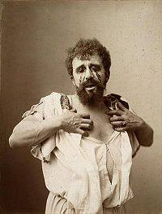
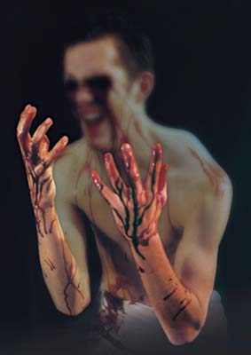

Slide 4
Comedy of Manners
A comedy where customs and manners of the day are over-emphasized for the dramatic effect.

Slide 5
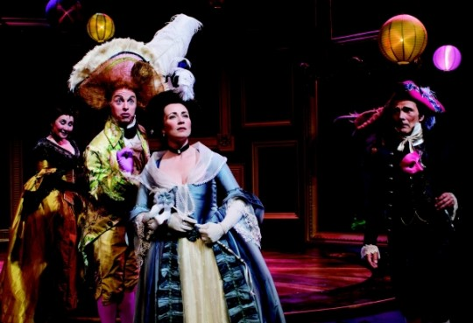

Slide 6
Melodrama
A play with a sensational plot and marked by crude appeals to emotion.

Slide 7
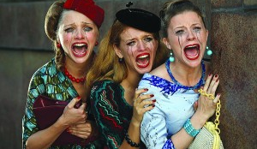

Slide 8
Farce
Drama intended only to amuse.

Slide 9
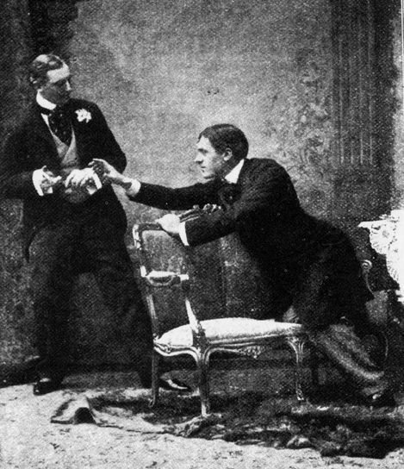
photograph from Act 1 of the original production of The Importance of Being Earnest (1895). It shows Algernon Moncrieff (left, played by Allan Aynesworth) refusing to return Mr Jack Worthing's (Sir George Alexander) cigarette case until the latter explains the inscription therein.

Slide 10
Realism
Realism is an aesthetic mode which broke with the classical demands of art to show life "as it is." The work of realistic art tends to depict the average, the commonplace, the middle classes and their daily struggle.

Slide 11
Mimesis
is a critical and philosophical term that carries a wide range of meanings, which include: imitation, representation, mimicry, the act of resembling, the act of expression, and the presentation of the self

Slide 12
Chorus
A band of singers, dancers or actors who often commented on the events of the play.

Slide 13
Archiac
No longer in ordinary use.
Wonted
Part of speech: adjective
Definition: accustomed; usual; ordinary
Example from Shakespeare:
And for your part, Ophelia, I do wish
That your good beauties be the happy cause
Of Hamlet's wildness: so shall I hope your virtues
Will bring him to his wonted way again (Queen Gertrude to Ophelia, Hamlet, Prince of Denmark, Act III, Scene I).

Slide 14
Prototype
The original thing in relation to any copy.

Slide 15
The Tragic Hero
According to Aristotle, the tragic hero has to be a man “who is not eminently good and just, yet whose misfortune is brought about not by vice or depravity, but by some error or frailty.”

Slide 16
Catharsis
Catharsis is a dramatic term in dramatic art that describes the "emotional cleansing”. It stands for an extreme change in emotion, occurring as the result of experiencing strong feelings (such as sorrow, fear, pity, or even laughter).

Slide 17
Hamartia
Hamartia is described by Aristotle as one of the three kinds of injuries that a person can commit against another person. Hamartia is an injury committed in ignorance (when the person affected or the results are not what the agent supposed they were).[3] In tragedy, hamartia is often described as a hero's fatal flaw.

