Slide 1

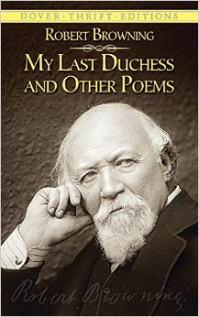
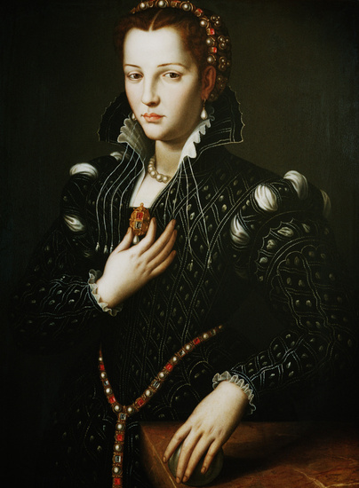
My Last Duchess

Slide 2
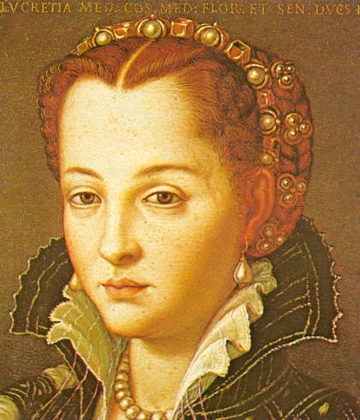
Subject
The speaker (the Duke of Ferrara) talks to the representative of a Count whose daughter he wishes to marry.
He shows this man a portrait of his previous wife. The portrait is usually kept behind a curtain.
He describes what his “last duchess” was like.
The Duke of Ferrara was a real person. He was Duke of Ferrara (in Italy) from 1559 to 1597.He was married three times and his first wife’s death was treated suspiciously – poisoning

Slide 3
Key points
The Duke is possessive – he chooses who does or does not see the Duchess – something he could not achieve when she was alive.
The Duke actually sees women as possessions – this is highlighted when he refers to the sculpture of Neptune which “Claus of Insbruck cast in bronze for me.” He also tells the messenger that “beauty is my object.”
The Duke did not tell the Duchess that he was displeased with her behaviour – he thinks that he would have been “stooping” or lowering his standards

Slide 4
Key points
Browning writes in rhyming couplets of ten syllables
The enjambment reveals the compulsive attitude of the duke
The casual sounding poem shows the pride and arrogance of the aristocracy
Is a portrait of a murderer
Shows the corruption of money
Shows the domination of men over women

Slide 5
Analysis of “My last Duchess”
At the beginning of the poem when the Duke is first introducing the painting he states: “Strangers like you that pictured countenance, the depth and passion of its earnest glance”(7).
By the Duke referring to the painting as, it, it is implied that the Duke has developed more of a relationship with the painting, than the woman this painting represents.

Slide 6
Analysis of “My last Duchess”
  Later in the Poem the Duke describes his wife’s imperfections
  “A heart—how shall I say?– Too soon made glad, Too easily impressed; She liked whate’er She looked on, and her looks went everywhere”(28).
  The Duke blames her for not seeing any difference between being the wife of a great man or any other simple pleasure. He believes she gave all men the kind of respect that only a man with his family’s rank deserves.

Slide 7
Analysis of “My last Duchess”
  Near the end of the poem, the Duke implies the Duchess’s death
  “Oh sir, She smiled, no doubt Whene’er I passed her; but who passed without Much the same smile? This grew; I gave commands; Then all smiles stopped together” (45).
  When ‘the smiles stopped’ the audience can assume that either the Duke restricted the Duchesses behavior in a way that dampened her life, or he may have ordered her assassination

Slide 8
The Duke is very possessive
Dramatic monologue
My Last Duchess
That's my last Duchess painted on the wall,
Looking as if she were alive. I call
That piece a wonder, now: Fra Pandolf's hands
Worked busily a day, and there she stands.
Will 't please you to sit and look at her? I said
"Fra Pandolf" by design, for never read
Strangers like you that pictured countenance,
The depth and passion of its earnest glance,
But to my self they turned (since none puts by
The curtain I have drawn for you, but I)
And seemed as they would ask me, if they durst,
How such a glance came there; so, not the first
Are you to turn and ask thus. Sir, 't was not
Her husband's presence only, called that spot
Of joy into the Duchess' cheek: perhaps
An imaginary artist, name dropping: everything has monetary value
He likes beautiful things
There is a reason for drawing the curtain, it’s so the person can see his prized possession

Slide 9
Fra Pandolf chanced to say, "Her mantle laps
Over my lady's wrist too much," or "Paint
Must never hope to reproduce the faint
Half-flush that dies along her throat:" such stuff
Was courtesy, she thought, and cause enough
For calling up that spot of joy. She had
A heart--how shall I say?--too soon made glad,
Too easily impressed: she liked whate'er
She looked on, and her looks went everywhere.
Sir, 't was all one! My favor at her breast,
The bough of cherries some officious fool
Broke in the orchard for her, the white mule
She rode with round the terrace--all and each
Would draw from her alike the approving speech,
Or blush, at least. She thanked men,--good! but thanked
Somehow,--I know not how--as if she ranked
My gift of a nine-hundred-years-old name
She was a modest person who got embarrassed by compliments
Her only crime was enjoying life and not respecting his rank/title
The Duke’s jealousy; he starts to reveal more than he planned
His only pride is in his wealthy family name
Contrast: genuine romance or a posh title, he expects her to value the latter more

Slide 10
With anybody's gift. Who'd stoop to blame
This sort of trifling? Even had you skill
In speech--(which I have not)--to make your will
Quite clear to such an one, and say, "Just this
Or that in you disgusts me; here you miss,
Or there exceed the mark"--and if she let
Herself be lessoned so, nor plainly set
Her wits to yours, forsooth, and made excuse,
--E'en then would be some stooping; and I choose
Never to stoop. Oh sir, she smiled, no doubt,
Whene'er I passed her; but who passed without
Much the same smile? This grew; I gave commands;
Then all smiles stopped together. There she stands
As if alive. Will 't please you rise? We'll meet
The company below, then. I repeat,
He accidentally reveals more of his weaknesses
What kind of man expects his wife to be rude like this?
He is getting jealous over her being kind
HE KILLED HER? Catholic renaissance Italy…
Makes monologue feel like conversation

Slide 11
Common Theme
  Pride- throughout the poem it is understood that in this hierachial society- people can be seen as objects which can be bought and owned.
  Art- Twice in this poem art is mentioned: the picture itself, and the statue of Neptune taming the see horses.

Slide 12
That’s my last Duchess painted on the wall, Looking as if she were alive. I call That piece a wonder, now; Fra Pandolf’s hands Worked busily a day, and there she stands. Will’t please you sit and look at her? I said “Fra Pandolf” by design, for never read Strangers like you that pictured countenance, The depth and passion of its earnest glance, But to myself they turned (since none puts by The curtain I have drawn for you, but I) And seemed as they would ask me, if they durst, How such a glance came there; so, not the first Are you to turn and ask thus. Sir, ’twas not Her husband’s presence only, called that spot Of joy into the Duchess’ cheek; perhaps Fra Pandolf chanced to say, “Her mantle laps Over my lady’s wrist too much,” or “Paint Must never hope to reproduce the faint Half-flush that dies along her throat.” Such stuff Was courtesy, she thought, and cause enough For calling up that spot of joy. She had A heart—how shall I say?— too soon made glad, Too easily impressed; she liked whate’er She looked on, and her looks went everywhere. Sir, ’twas all one! My favour at her breast, The dropping of the daylight in the West, The bough of cherries some officious fool Broke in the orchard for her, the white mule She rode with round the terrace—all and each Would draw from her alike the approving speech, Or blush, at least. She thanked men—good! but thanked Somehow—I know not how—as if she ranked My gift of a nine-hundred-years-old name With anybody’s gift. Who’d stoop to blame This sort of trifling? Even had you skill In speech—which I have not—to make your will Quite clear to such an one, and say, “Just this Or that in you disgusts me; here you miss, Or there exceed the mark”—and if she let Herself be lessoned so, nor plainly set Her wits to yours, forsooth, and made excuse— E’en then would be some stooping; and I choose Never to stoop. Oh, sir, she smiled, no doubt, Whene’er I passed her; but who passed without Much the same smile? This grew; I gave commands; Then all smiles stopped together. There she stands As if alive. Will’t please you rise? We’ll meet The company below, then. I repeat, The Count your master’s known munificence Is ample warrant that no just pretense Of mine for dowry will be disallowed; Though his fair daughter’s self, as I avowed At starting, is my object. Nay, we’ll go Together down, sir. Notice Neptune, though, Taming a sea-horse, thought a rarity, Which Claus of Innsbruck cast in bronze for me!

Slide 13
Analysis of "My Last Duchess" by Robert Browning
Victorian Features in "My Last Duchess"
Intellectual and Spiritual Doubt:
  The Duke's monologue reveals a subtle critique of the era's moral and ethical values, particularly in relation to power and control within relationships. For example, "She had a heart—how shall I say?— too soon made glad, Too easily impressed," illustrates the Duke’s skepticism about genuine emotions and his doubt over his control and influence.
Sadness or Melancholy:
  While not overtly sad, the poem's undertone reflects a melancholic disdain for the Duke's late wife, whose spirit and independence he could not appreciate. This is evident in "Then all smiles stopped together. There she stands As if alive," indicating the tragic outcome of her vibrant life due to her husband's displeasure.
Sense of Realism:
  The Duke's pragmatic view of relationships and art is depicted through his transactional discussion of the marriage portrait and the planned marriage to his next Duchess. This practicality, devoid of emotional depth, "The Count your master’s known munificence Is ample warrant that no just pretense Of mine for dowry will be disallowed," highlights the commodification common in Victorian marriages.
Scepticism:
  Browning encapsulates Victorian scepticism in the Duke's critique of the Duchess's indiscriminate friendliness, which he saw as undervaluing his aristocratic status. "As if she ranked My gift of a nine-hundred-years-old name With anybody’s gift" reflects the era's anxiety over social status and hierarchy.

Slide 14
Stylistic Devices in "My Last Duchess"
Dramatic Monologue:
  This poem is a quintessential example of a dramatic monologue, a form Browning mastered. The entire poem is spoken by the Duke, providing insight into his character and motivations indirectly through his own words.
Irony:
  Browning uses irony throughout the Duke’s speech. The Duke presents himself as reasonable and wronged, yet his actions reveal his tyrannical and possessive nature, "I gave commands; Then all smiles stopped together." This contrast between self-presentation and actions deepens the critique of Victorian social norms.
Symbolism:
  The portrait of the Duchess symbolizes control and objectification in art and relationships. The Duke’s ability to control who sees the portrait mirrors his controlling nature in life, “none puts by The curtain I have drawn for you, but I.”
Enjambment:
  Browning’s use of enjambment, where sentences and phrases flow beyond the line breaks, mirrors the Duke’s manipulative and flowing rhetoric. It creates a sense of natural speech while also pulling the reader along through the Duke's twisted reasoning.
Through "My Last Duchess," Browning not only explores themes of power, control, and social hierarchy but also critiques Victorian society’s moral and ethical underpinnings. The poem's structure and stylistic devices cleverly reveal the Duke's character and the societal norms that enable his behavior.

