Slide 1





Presentation skills are the skills you need in delivering effective and engaging presentations to a variety of audiences. These skills cover a variety of areas such as:
the structure of your presentation, the design of your slides,
the tone of your voice
and the body language you convey.

Slide 2

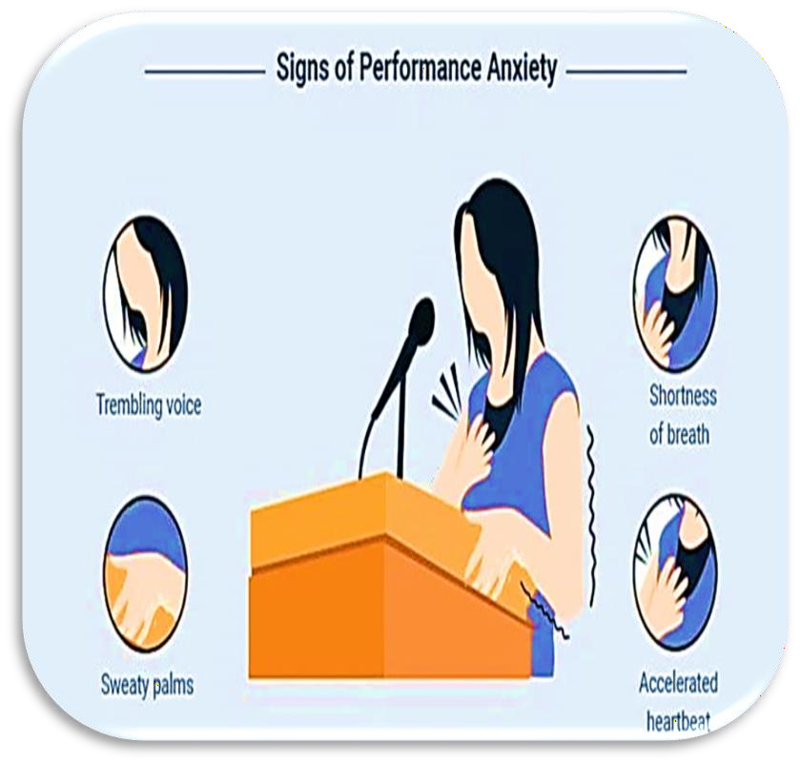

















THE FACTS: Shaky hands,
blushing cheeks, memory loss,
Trembling voice
Shortness of breath
Accelerate heartrate

Slide 3

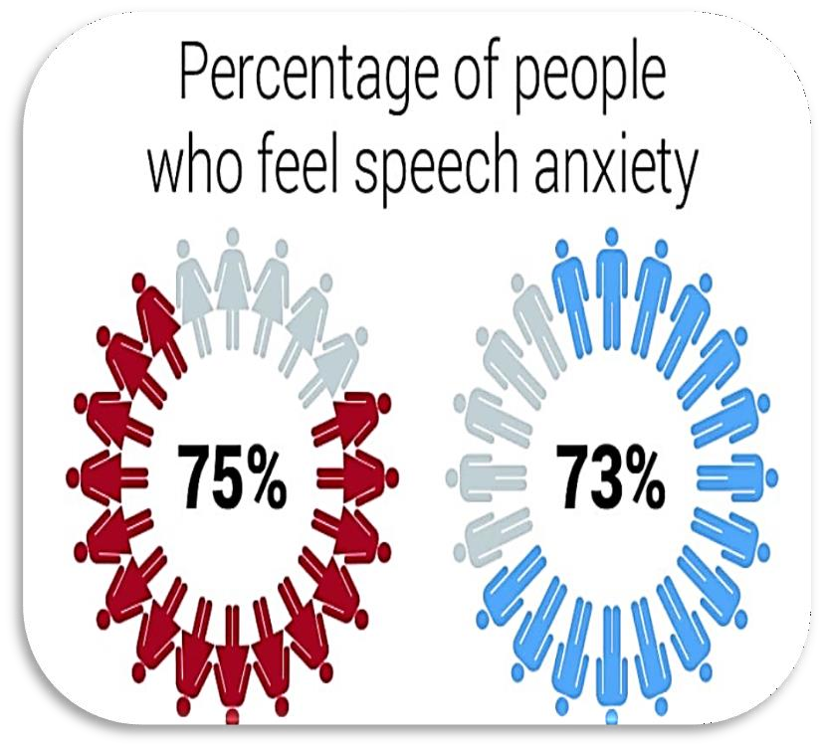












Fear of the Unknown
Loss of Control
No Enthusiasm For Subject

Slide 4








Slide 5
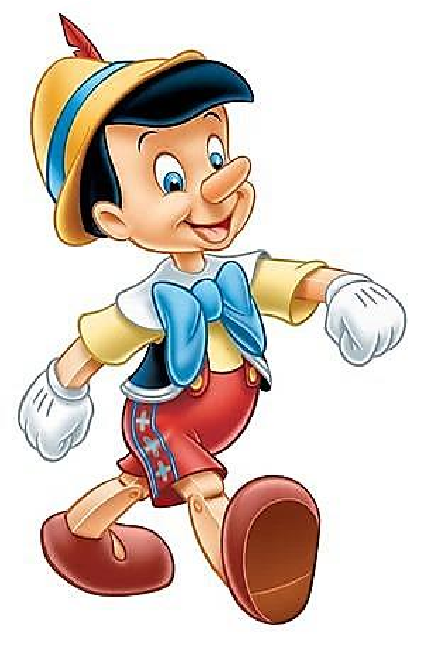













Slide 6



Slide 7







Slide 8









Slide 9










Slide 10








…What is important to them?
…What information do they want?
…Understand their level of knowledge on the subject and target them appropriately

Slide 11


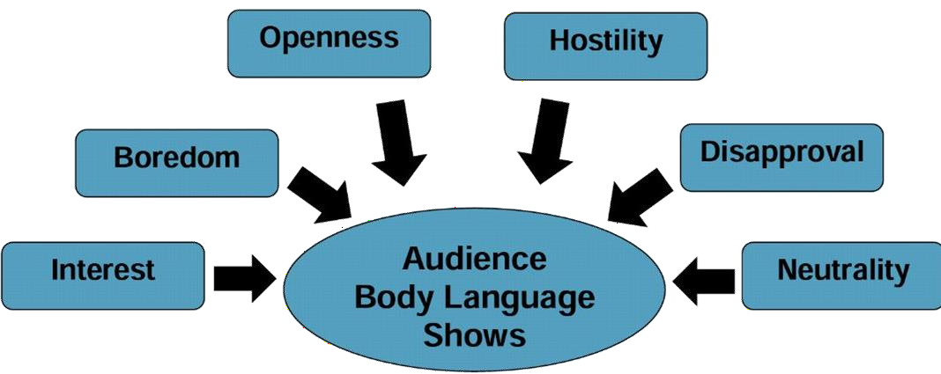























Reading the audience’s body language can help you modify the pace of your delivery
It can also help you to gauge who is in agreement with you,
who is opposing your point of view, and who has yet to decide
Depending upon the nature of the presentation

Slide 12
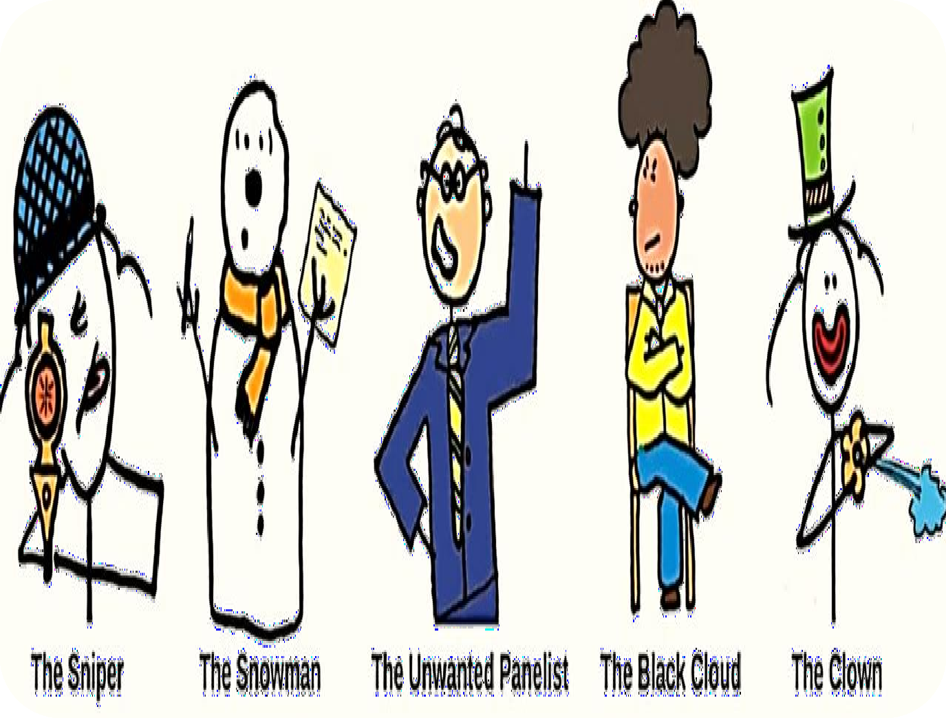

Slide 13










Emotonal
Novel
Memorable

Slide 14





























: Identify your unique and
meaningful connection to your topic.
Passion leads to mastery and your presentation is nothing without it
: Tell stories to reach people’s hearts and minds
: Practice relentlessly and
internalize your content

Slide 15




























: Reveal information that’s completely new to your audience
the brain loves humor.
Give your audience something to smile about.

Slide 16

















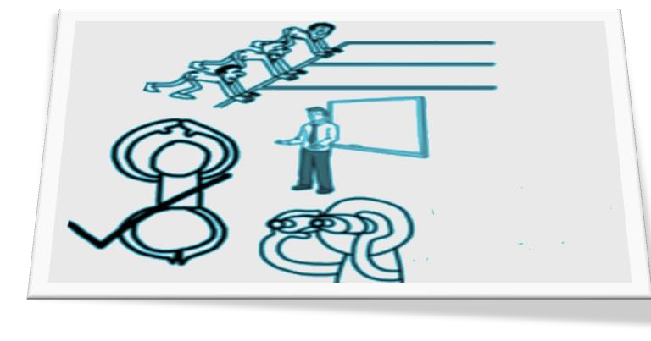






















: Eighteen minutes is the ideal length of time for a presentation
Be authentic, open, and
transparent
Deliver presentations with components that touch more than one of the senses: sight, sound, touch, taste, and smell.

Slide 17















Open Body Posture
Eye Contact
Facial Expressions
Gestures

Slide 18





































➢
Make 3-5 seconds contact
Do not read notes or the screen
Face the audience, not the screen
Maintain visual contact with your listeners until they feel “seen.”
Be sure to make eye contact with everyone, or, when speaking with large groups, with all parts of your audience.

Slide 19
















➢
Pleasant facial expression – smile!
Effective gestures to emphasize meaning
Preparation and good timing

Slide 20



















➢
Volume
  Speak to the back of the room
Variation
  Vary your pitch and volume
Pauses
  Pause to emphasize

Slide 21





















➢
Speak at reasonable pace
Use inflection
Project your voice. Do not mumble.
Talk to the audience: Not screen, camera, notes, or self
Use professional language. Avoid idioms / slang.

Slide 22




















➢
Ask for questions
Be receptive to questions
Wait for questions
Group presentations – decide as a team who will answer the question

Slide 23

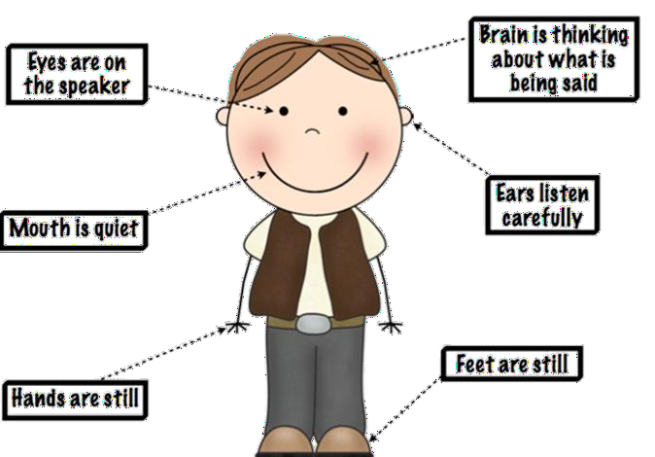

Slide 24

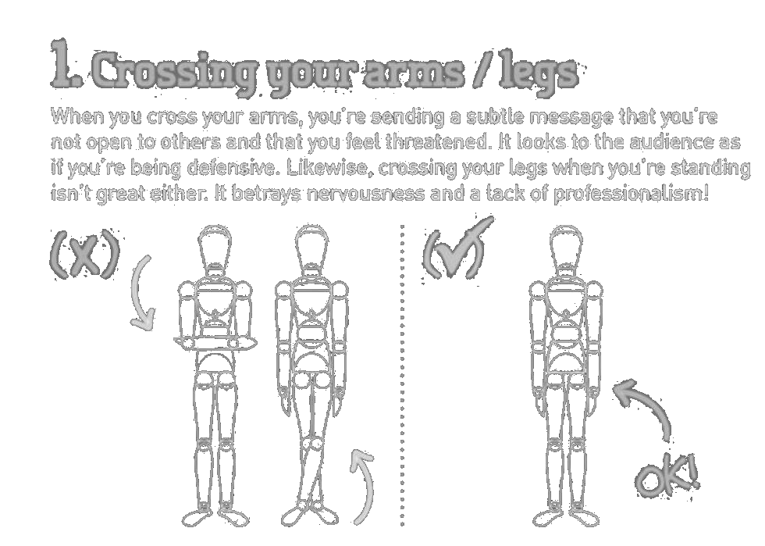

Slide 25
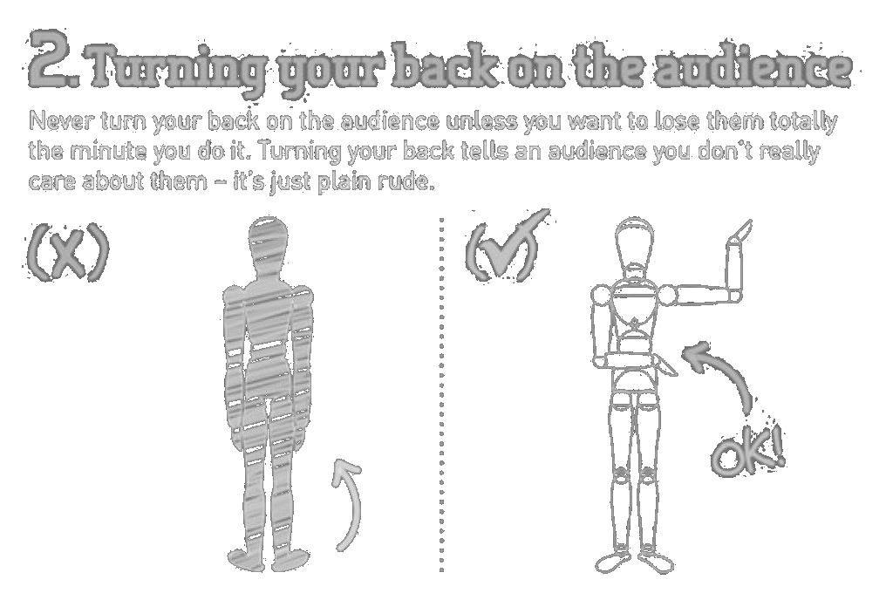

Slide 26

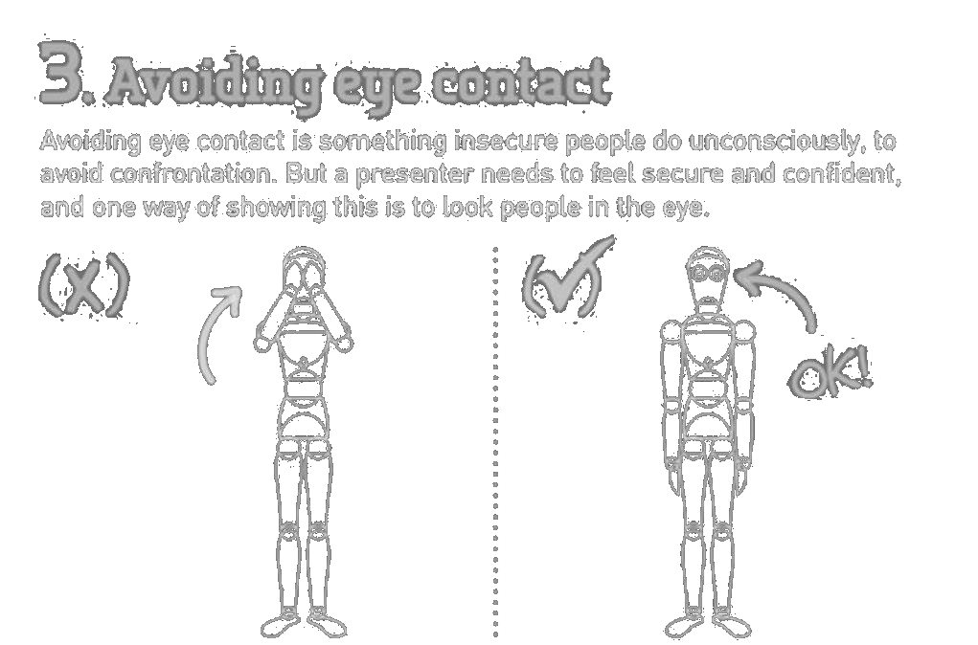

Slide 27
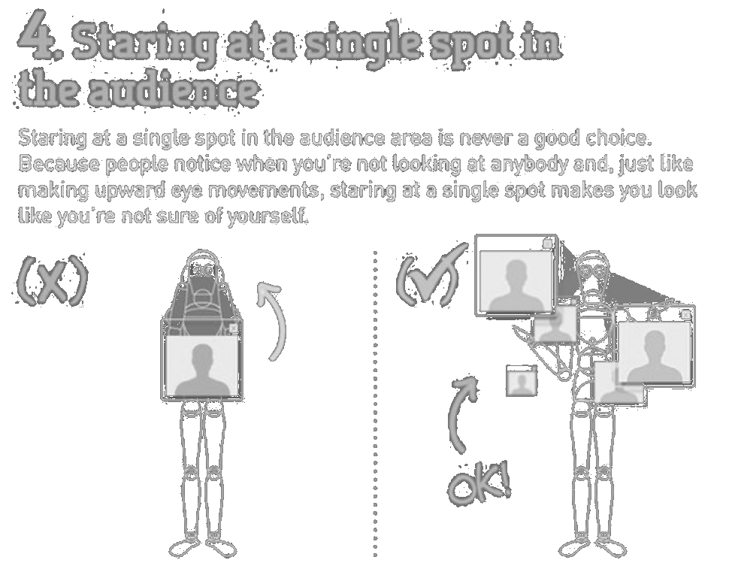

Slide 28
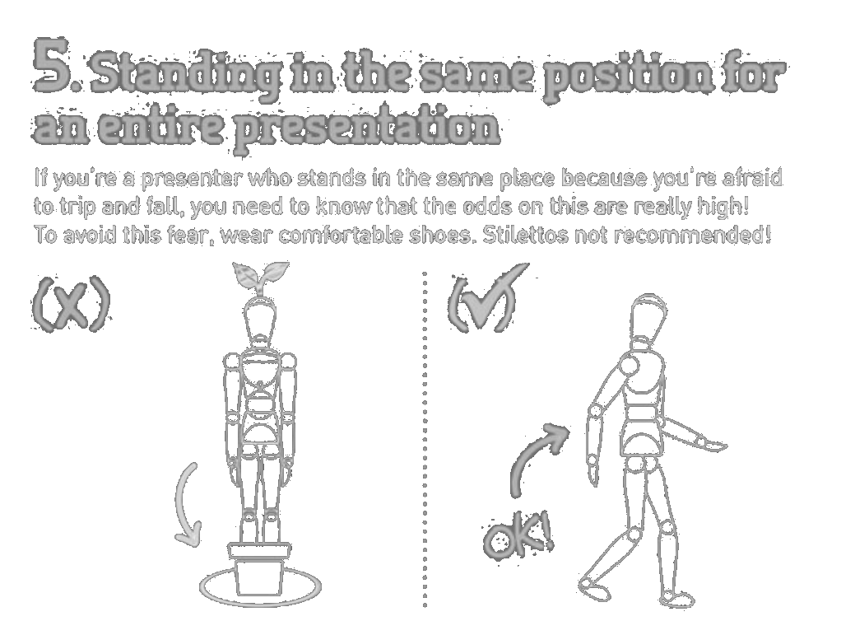

Slide 29
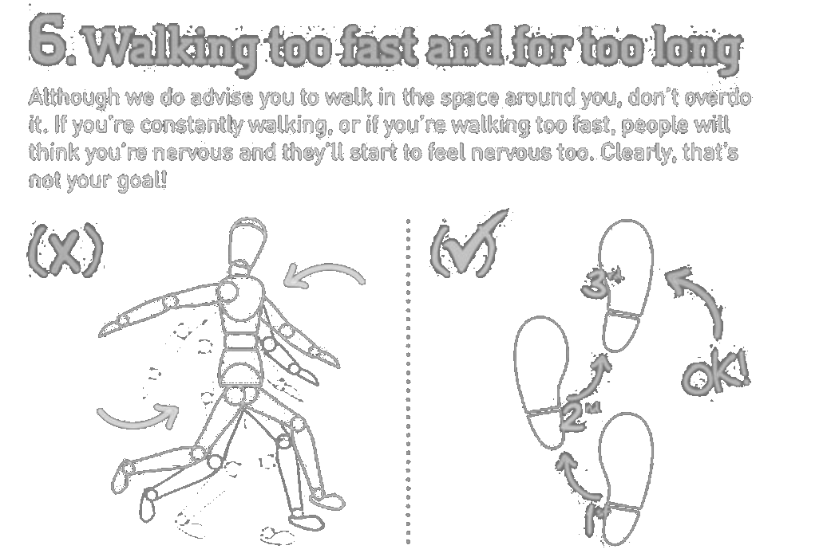

Slide 30
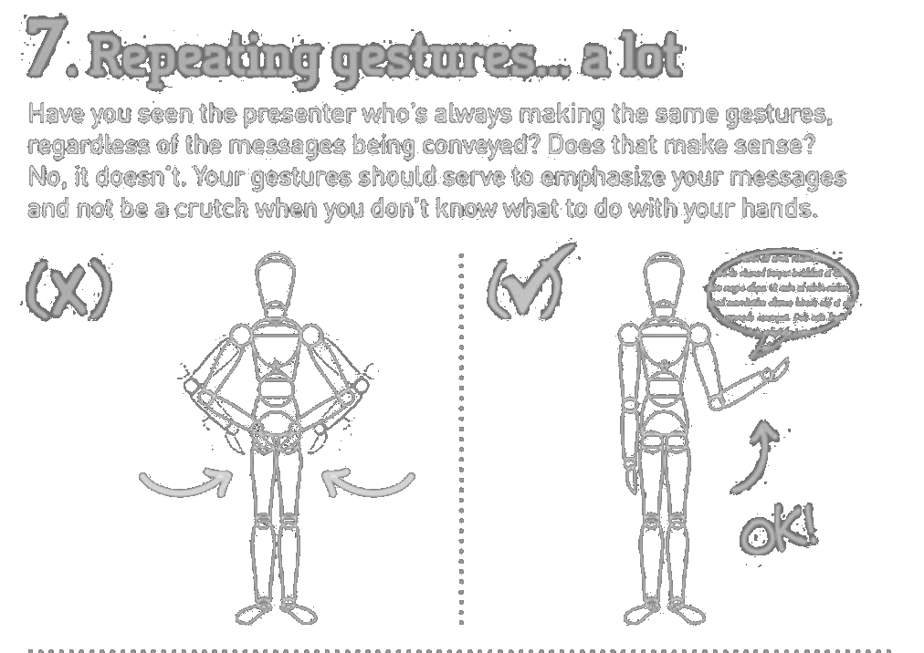

Slide 31
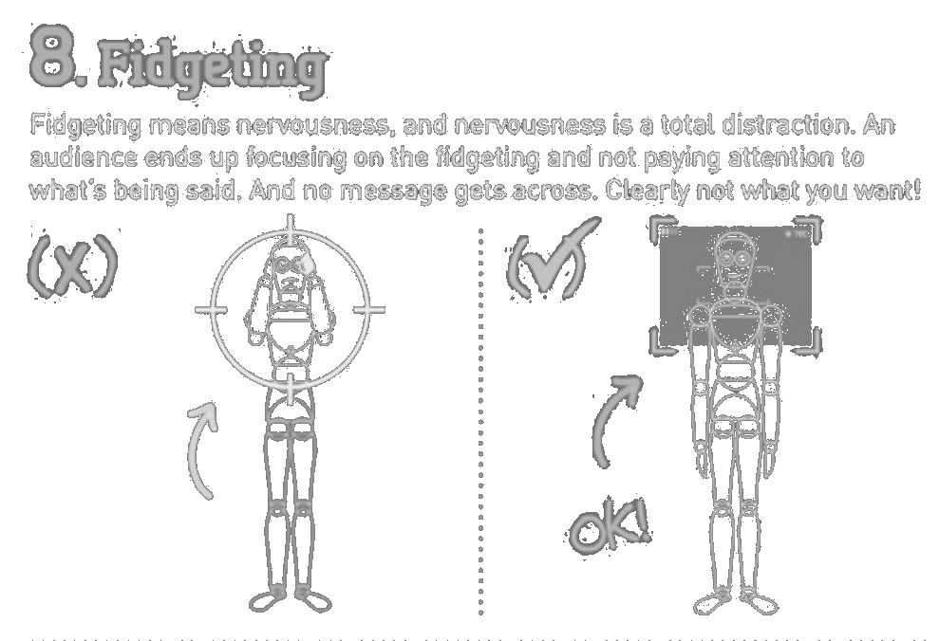

Slide 32

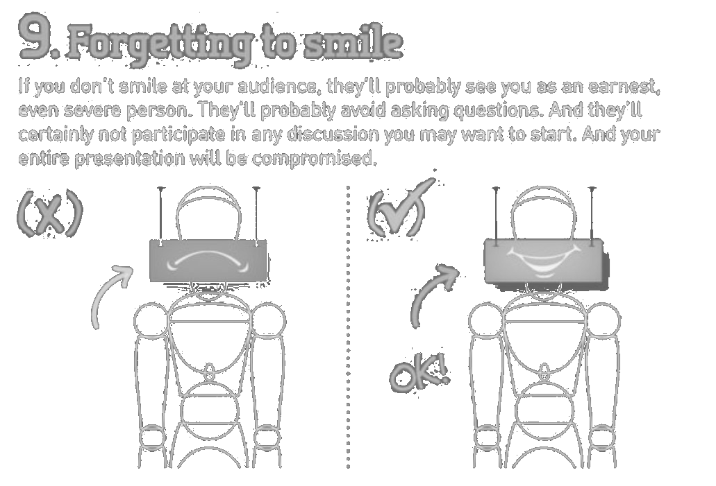

Slide 33
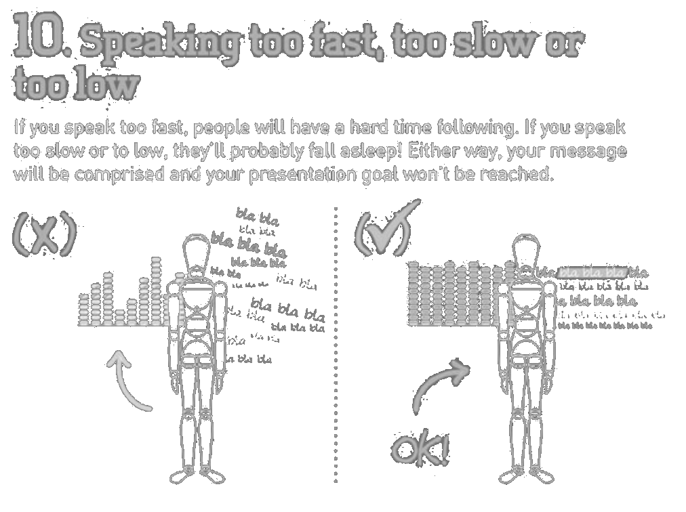

Slide 34































Appearance
Interesting Voice

Slide 35

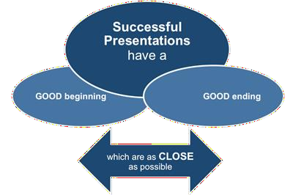


















Beginning
1 minute
Body
10_15 min
Ending
3 min

Slide 36


