Slide 1


Effective Presentation Skills

Slide 2
“Great speakers aren’t born, they are trained.”
Presenting is a skill…
developed through experience and training.

Slide 3

Agenda
Introduction
Planning Your Presentation
The Presentation Sequence
Presentation Techniques
Creating Effective Visual Aids
Practice

Slide 4

Causes of the Anxiety
Fear of the Unknown OR Loss of Control
Fight or Flight Mode
No Backup Plan
No Enthusiasm For Subject
Focus of Attention

Slide 5

Rise above the Fears…
Give yourself the opportunity to succeed
Be well prepared. Plan carefully.
Know your subject matter thoroughly
Time yourself during practice
Gain experience
Experience builds confidence
Concentrate on the message
Believe in yourself!!!!

Slide 6
‘but how can I get practice’
Speak whenever you get the opportunity
Find your own particular strengths and weaknesses
Learn to exploit your strengths and avoid your weaknesses

Slide 7


Be Prepared!!!
SHOW ENTHUSIASM!!

Slide 8
Part 2:
Planning Your Presentation

Slide 9
Keys to Presentation Excellence
Planning: think the whole process through
      Objectives
      Occasion
      Audience

Slide 10
Planning Your Presentation
Determine Purpose
Assess Your Audience
  “Success depends on your ability to reach your audience.”
  Size
  Demographics
  Knowledge Level
  Motivation

Slide 11
Planning contd.
Plan Space
  Number of Seats
  Seating Arrangement
  Audio/Visual Equipment
  Distracters
What Day and Time?
  Any Day!
  Morning, preferably

Slide 12
Planning contd.
Organization
  Determine Main Points (should be 2 to 5)
  Evidence
  Transitions
  Prepare Outline

Slide 13
Organizing Your Presentation
Organizing Patterns
Topical
Chronological
Problem/Solution
Cause/Effect

Slide 14
Tips to be kept while organizing
Requires an introduction and a conclusion
Should be logical and systematic
‘Look after the beginning and the end…and the middle will take care itself.’
‘Men perish because they cannot join the beginning with the end.’

Slide 15
Presentation Outline
Keyword Reminders
Conversational Flow
Flexibility
More Responsive to Audience

Slide 16
Part 3:
The Presentation Sequence

Slide 17


#1: Build Rapport
… relation marked by harmony or affinity
  Audience members who trust you and feel that you care
Start Before You Begin
  Mingle; Learn Names
  Opportunity to reinforce or correct audience assessment
  Good First Impression
People Listen To People They Like

Slide 18
#2: Opening Your Presentation
Introduce Yourself – Why Should They Listen
Get Attention, Build More Rapport, Introduce Topic
  Humor
  Anecdote
  Startling Statistic
  Make Audience Think
  Invite Participation
Get Audience Response

Slide 19

#2…Completing the Opening
Clearly Defining Topic
If Informative…
  Clear parameters for content within time
If Persuasive…
  What’s the problem
  Who cares
  What’s the solution
Overview

Slide 20
#3: Presenting Main Points
Main Point – Transition - Main Point -Transition - Main Point……
Supporting Evidence
Examples
Feedback & Questions From Audience
Attention to, and Focus on, Audience

Slide 21
#4: Concluding Your Presentation
Goal
Inform audience that you’re about to close
Summarize main points
Something to remember or call-to-action
Answer questions
“Tell Them What You Told Them.”

Slide 22
#5: Question Round
ASKING QUESTIONS TO THE AUDIENCE
ask "friendly" questions and avoid asking risky questions
don't let respondent wander or attempt to take control of the presentation
if extensive audience discussion is desired, avoid isolated one-on-one dialogues with specific individuals
when challenged, be candid and firm but avoid over responding
maintain control of the session and be firm and assertive without being aggressive or defensive
don't let interruptions disrupt your composure

Slide 23
Guideline for Answering Questions
Anticipate Questions: think of the ten most likely questions and plan out your answer
Understand the Question: paraphrase it if necessary; repeat it if needed
Plan the Answer: particularly if you anticipated the question
Do Not Digress
Be Honest: if you can't answer the question, say so

Slide 24
Part 4:
Effective Presentation Techniques

Slide 25
Presentation Style
3 Elements
Vocal Techniques
  Loudness
  Pitch
  Rate
  Pause
Deviations From the Norm for Emphasis

Slide 26
Presentation Style (contd.)
Body Language
  Eye Contact, Gestures, Posture
Use of Space
  Can Everyone See You?
  Movement

Slide 27
Common Problems
Verbal fillers
  “Um”, “uh”, “like”
  Any unrelated word or phrase
Swaying, rocking, and pacing
Hands in pockets
Lip smacking
Fidgeting
Failure to be audience-centered

Slide 28

Five Presentation Tips
Smile
Breathe
Water
Notes
Finish On Or Under Time

Slide 29
Part 5:
Creating Effective Visual Aids

Slide 30
Visual Aids
Enhance Understanding
Add Variety
Lasting Impact
Used Poorly A Distraction Ineffective Presentation

Slide 31
Visual Aids - Examples
PowerPoint Slides
Overhead Trans
Graphs/Charts
Pictures
Films/Video
Flip Charts
Sketches

Slide 32

Keys to Presentation Excellence
Practice and more practice:
  perfecting the delivery
  well-timed
  comprehensible
  convincing

Slide 33
Delivery of the Talk
Be yourself! And look at the audience!
Concentrate on the preparation and on the four qualities below
-conviction/sincerity
-enthusiasm
-power of speech
-simplicity
These are the basic ingredients of all effective communication

Slide 34
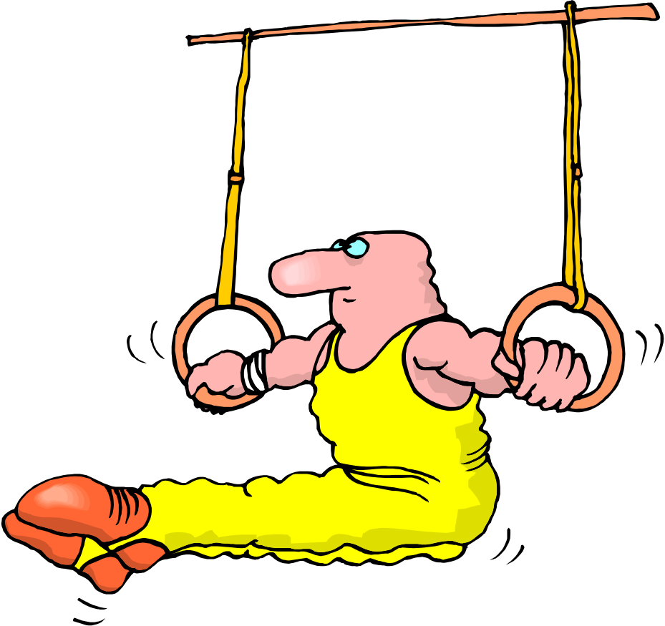
PRACTICE……And More Practice!!!
PRACTICE MAKES A MAN PERFECT!!!

