Slide 1
TRANSLATION

Slide 2
Why it is imp. To study Translation?
Translation from Arabic into English is a crucial skill for individuals and businesses alike.
The Arabic language is one of the most spoken languages in the world, and being able to communicate effectively in both Arabic and English can lead to numerous opportunities.
The Arabic Group is a leading provider of translation services from Arabic into English, offering high-quality and accurate translations.

Slide 3
Arabic is the fifth most spoken language in the world, with over 420 million speakers.
The Arab world is a significant economic force, with numerous business opportunities.
Arabic is the language of the Quran, and many religious, cultural, and historical texts are written in Arabic.
The ability to translate Arabic into English is essential for communication, education, and cultural understanding.

Slide 4
Challenges
The Arabic language has a complex grammar and syntax that can be challenging for non-native speakers to understand.
Arabic is written from right to left, which can be confusing for English speakers.
There are numerous regional dialects of Arabic, which can differ significantly in grammar, vocabulary, and pronunciation.
Cultural differences can also affect the translation process.

Slide 5
CONTENTS
WHAT IS TRANSLATION ?
WHY TRANSLATION ?
WHAT IS GOOD TRANSLATION ?
KINDS OF TRANSLATION
CHALLENGES OF TRANSLATION

Slide 6

WHAT IS TRANSLATION ?
The skilful art of re-creating an equivalent message of a work of art originally created in one language in another language.

Slide 7
WHY TRANSLATION ?
To “affect” larger audiences .
Promoting mother tongues .
Reviving dead/dying languages .
Historical changes in languages .

Slide 8
A GOOD TRANSLATOR
Bilingual , bicultural proficiency .
Transparency in grammar , syntax and idiom .
Thorough perception of the text / content .
Loyalty to emotion , style .
Artistic correspondence .
Fidelity to detail and faithfulness to text .
Aesthetic matching the original .

Slide 9
KINDS OF TRANSLATION
SOURCE LANGUAGE EMPHASIS
TARGET LANGUAGE EMPHASIS
WORD –FOR-WORD
ADAPTATION
LITERAL
FREE/DYNAMIC
FAITHFUL
IDIOMATIC
SEMANTIC
LITERARY

Slide 10
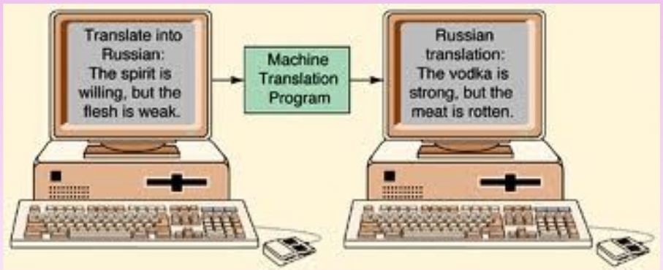
DISASTERS OF MACHINE TRANSLATION

Slide 11
TRANSLATION–SOME CHALLENGES
Linguistic untranslatability .
Cultural untranslatability .
Source text .
Ambiguities .
Time , effort and expenditure .

Slide 12
CHALLENGES OF TRANSLATION
!= LEXICAL
!= STRUCTURAL
!= CULTURAL
!= ETHICAL
!= POLITICAL
!= AMBIGUITY

Slide 13
FACTS OF TRANSLATION ?
Living languages in the world – 6912 .
Languages spoken in INDIA – about 1600 .
Language with the most words: ENGLISH (approx. 250,000 distinct words ) .
Language with the fewest words: TAKI TAKI , also called SRANAN (only 340 words ) .

Slide 14
When translating from English to Arabic, here are some main points to consider, especially for beginners:
Writing System:
  English is written from left to right, using the Latin alphabet.
  Arabic is written from right to left, using the Arabic script.
Sentence Structure:
  English typically follows a Subject-Verb-Object (SVO) order.
  Arabic often uses a Verb-Subject-Object (VSO) or Subject-Object-Verb (SOV) order, depending on the context.
Verb Conjugation:
  English has relatively simpler verb conjugations.
  Arabic verbs are conjugated based on gender, plurality, and tense, which can be complex.

Slide 15
Definiteness and Articles:
  English uses definite (the) and indefinite (a, an) articles.
  Arabic uses the definite article (al-) but does not have a direct equivalent for indefinite articles, instead using the concept of "tanween" to imply indefiniteness.
Gender:
  English generally does not have gendered nouns.
  Arabic nouns are gendered (masculine or feminine), which affects adjective agreement and verb conjugation.
Formality and Register:
  English uses the same word forms across different levels of formality but changes the sentence structure or vocabulary.
  Arabic has formal (Modern Standard Arabic) and colloquial (dialectal) levels, which can differ significantly in vocabulary, structure, and pronunciation.
Idioms and Cultural References:
  Direct translation of idioms, proverbs, or cultural references may not convey the same meaning in Arabic. It’s important to find equivalent expressions that preserve the intent and tone.

Slide 16
Here are some exercises for each of the points mentioned above to help you practice translating from English to Arabic:
1. Writing System
Exercise:
Write the English sentence "The quick brown fox jumps over the lazy dog." in Arabic script, maintaining the English words.
2. Sentence Structure
Exercise:
Translate the English sentence "She reads books." to Arabic, then rearrange the sentence to fit typical Arabic structure.
3. Verb Conjugation
Exercise:
Take the verb "to write" in English and conjugate it in past tense for he, she, and they in Arabic.

Slide 17
4. Definiteness and Articles
Exercise:
Translate "A book on the table" and "The book on the table" into Arabic, noting how indefiniteness and definiteness are expressed.
5. Gender
Exercise:
List five common English nouns (like "teacher", "book", "car", "nation", "apple"). Translate them into Arabic and specify their gender.
6. Formality and Register
Exercise:
Write a simple sentence in English, such as "I need to go to the hospital." Translate it into Modern Standard Arabic and then into a colloquial dialect of your choice.
7. Idioms and Cultural References
Exercise:
Take the English idiom "Break a leg" and translate it into Arabic. Find an Arabic idiom that conveys a similar meaning of wishing someone good luck.

Slide 18
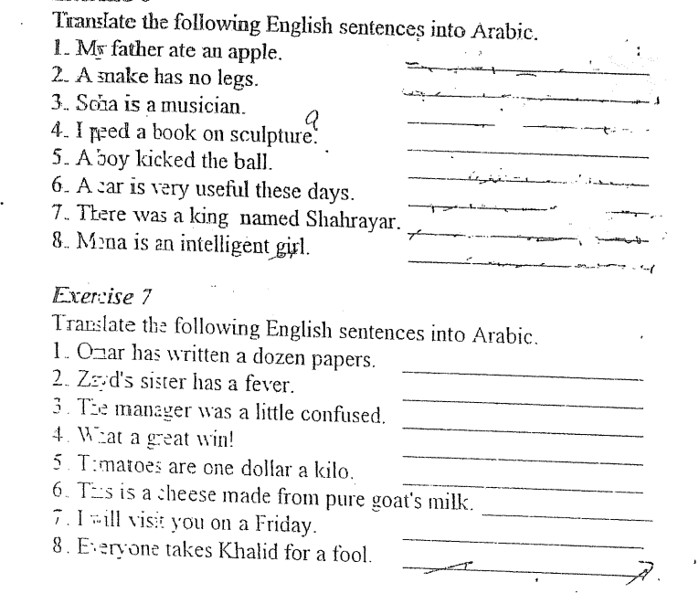

Slide 19
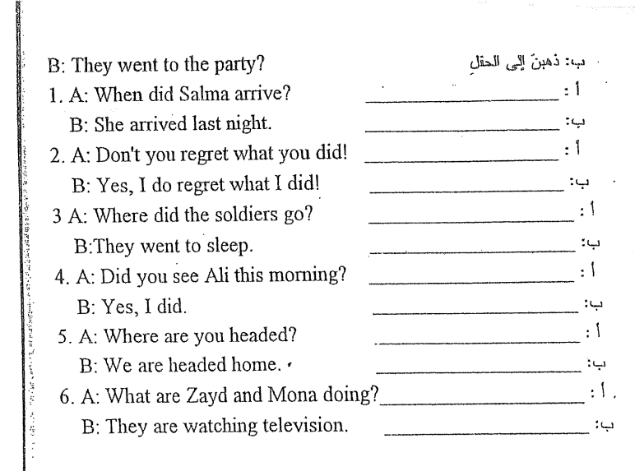

Slide 20
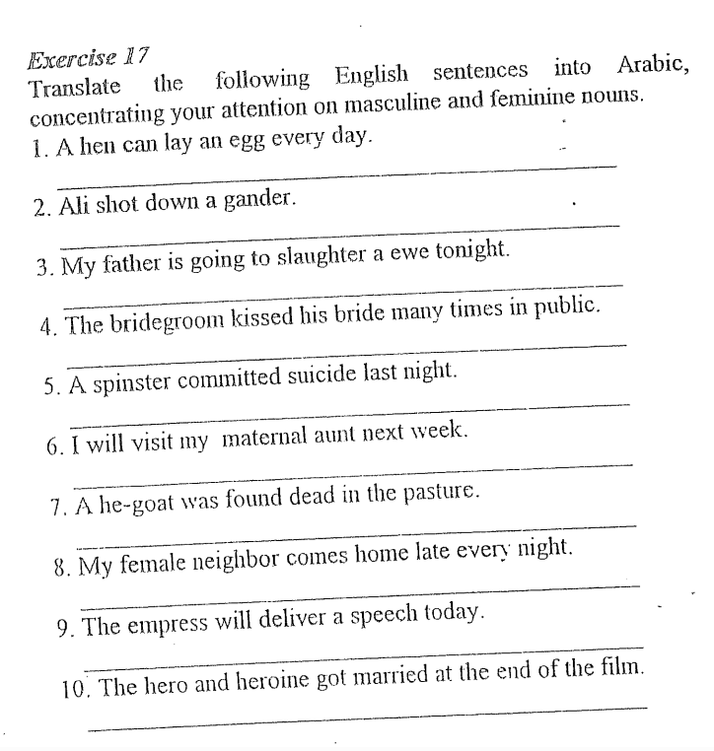

Slide 21
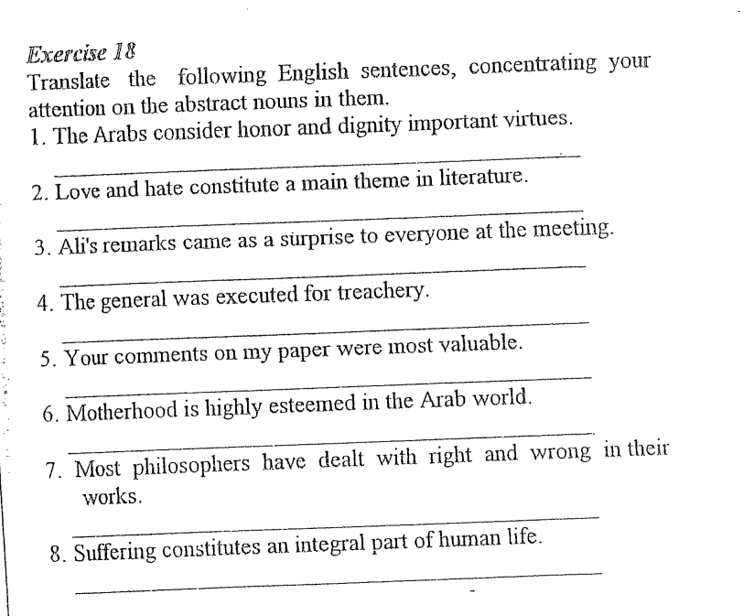

Slide 22
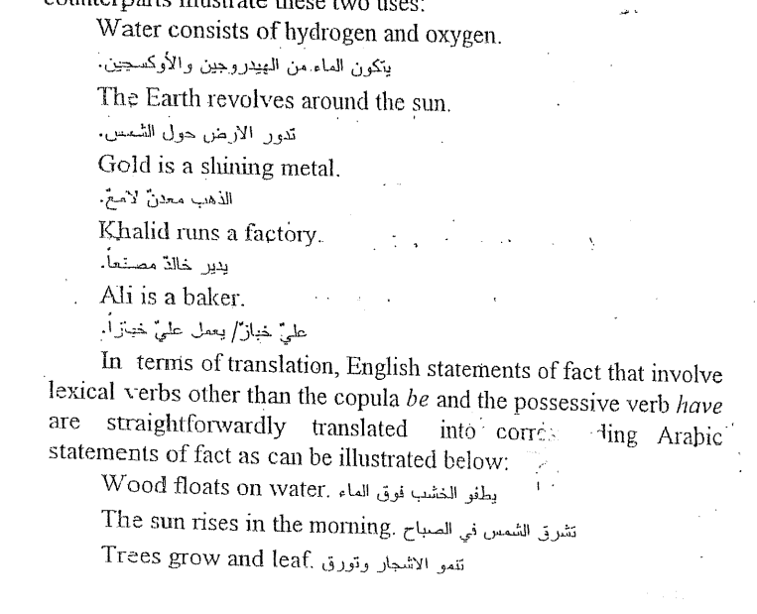

Slide 23
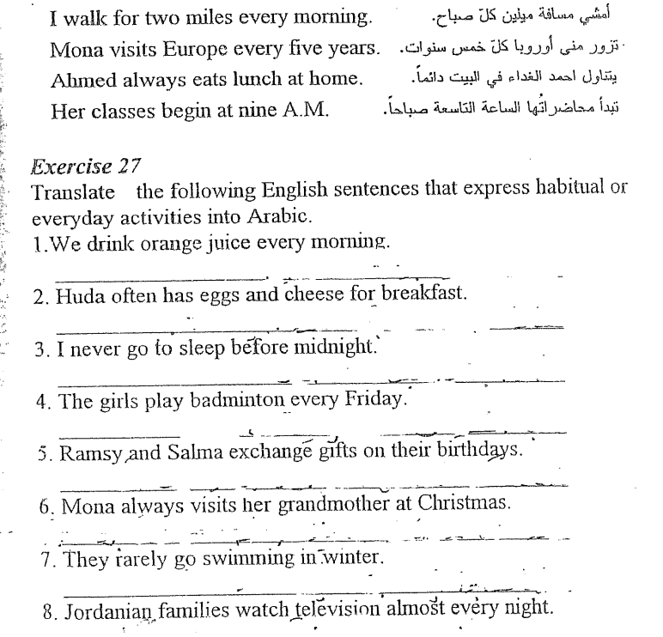

Slide 24
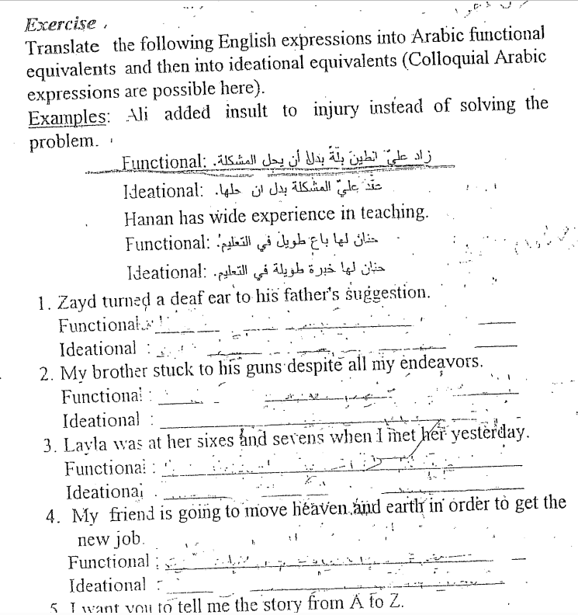

Slide 25
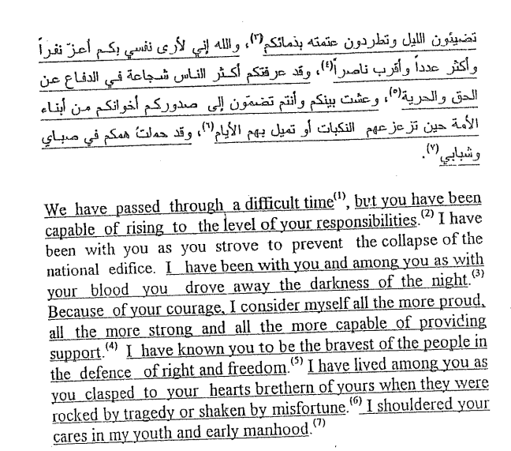

Slide 26


Slide 27
THANK YOU

