Slide 1
Hello Once More
Translation-118- 3rd class

Slide 2
Translation of verb “Be”:
Am
Is
Are
Was
Were
Be
been

Slide 3
Am: I am a student.
Is: She is invited to a party.
Are: They are put in the same situation.
Was: The food was eaten.
Were: The boys were dismissed.
Be: You can be a good citizen.
Been: They had been released.

Slide 4
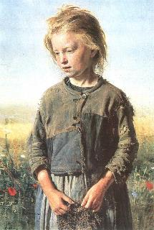
She is a kid

Slide 5
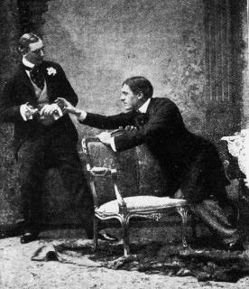
They are fighting

Slide 6
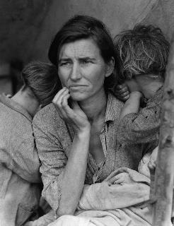
She was depressed

Slide 7
Translation of verb “Do”
Negative form: The horse did not fall down
Question form: Do you sleep early.
As a substitute verb: Do they work at night, No, they don’t.

Slide 8
She does not seem happy

Slide 9
He doesn’t agree

Slide 10


Slide 11
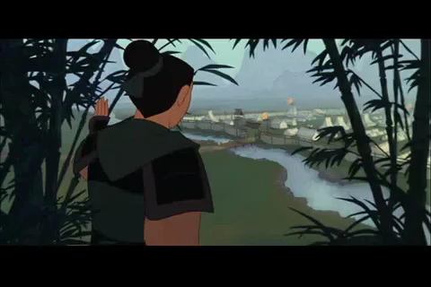

Slide 12
End of Class
Have a great weekend ☺

