Slide 1
Descriptive Writing
A Student’s Guide

Slide 2
An Introduction
Descriptive Writing tries
* to capture the details of an object, a person, a place or an experience using images of sight , sound, smell, taste and touch
  * to create vivid, colourful pictures by using adjectives, adverbs and imagery such as metaphors and similes
* to create a mental image using words to create atmosphere and mood

Slide 3
Steps to follow
1. Understand the subject of your description
2. Brainstorm
3. Write a first draft
4. Re-read
5. Proofread
6. Rewrite

Slide 4

Hanoi – a bustling city in Vietnam

Slide 5
Understanding the subject
1. Ask yourself the following questions :
Are there any details that stand out ?
Are there any reminders of an experience you may have had, a
place you may have seen or a person you may know ?
What feelings and thoughts does the topic stir in you ?
2. Record the sights, smells, sounds, tastes and textures of the
experience, place or memory you associate with the topic.

Slide 6
Brainstorming
Create a mind map, flow chart or a list
Use the five senses as your sub-headings
Write down adjectives and abstract nouns describing what you experience with each of your senses
Try to turn some of the words which you’ve written into figures of speech that will make the images come alive

Slide 7
Brainstorming suggestion
Topic
Words to use in my description
Things I could taste
Things I could hear
Things I could see
Things I could smell
Things I could touch

Slide 8
Writing a first draft and rereading
Use the sub-headings in your plan as topics for each paragraph and write a first draft
Assume that your reader cannot see the picture – aim to create a sensory image
Once you have completed writing reread your attempt.
Ask yourself – does it recreate the images I am trying to convey ?

Slide 9
Proofreading and rewriting
Polish your word choice
Remove unnecessary words, informal language and ambiguity
Restructure and reorder your sentences and paragraphs
Add more information and connect your ideas using effective linking words
Ensure you retain the same tense throughout your description
Check punctuation and spelling
Proofread your writing one more time before neatly rewriting and presenting it

Slide 10
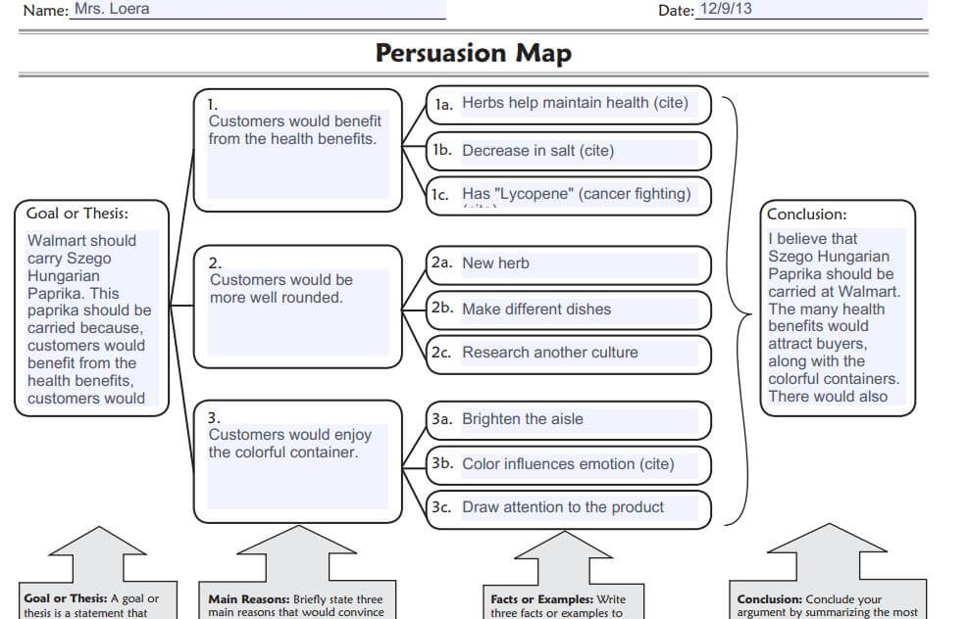

Slide 11

Descriptive Paragraph

Slide 12
It's a sunny day by the river. The water is flowing slowly, making a soft splashing sound. There are many trees, which make good shade. A stone bridge crosses over the river. It looks very old. A girl is setting up a picnic. She is happy and smiling. In the end, the riverbank is a peaceful place to enjoy a sunny day.

Slide 13


Slide 14
City Park in Autumn
This image features a bustling city park during the fall. Children are playing with colorful leaves, and families are enjoying picnics under trees with red and orange foliage. There's also a pond with ducks in the background.

Slide 15


Slide 16
Beach Scene on a Sunny Day:
This scene captures a sunny day at the beach. Families are building sandcastles, children are flying kites, and there are colorful beach umbrellas and towels spread out. A small snack stand is visible in the distance near the ocean.

Slide 17


