Slide 1
Recap
Presenter name

Slide 2

Agenda
Recap for the test
Intro
Conclusion
Connectors

Slide 3
There are three reasons why Canada is one of the best countries in the world. First, Canada has an excellent health care system. All Canadians have access to medical services at a reasonable price. Second, Canada has a high standard of education. Students are taught by well-trained teachers and are encouraged to continue studying at university. Finally, Canada's cities are clean and efficiently managed. Canadian cities have many parks and lots of space for people to live. As a result, Canada is a desirable place to live.

Slide 4
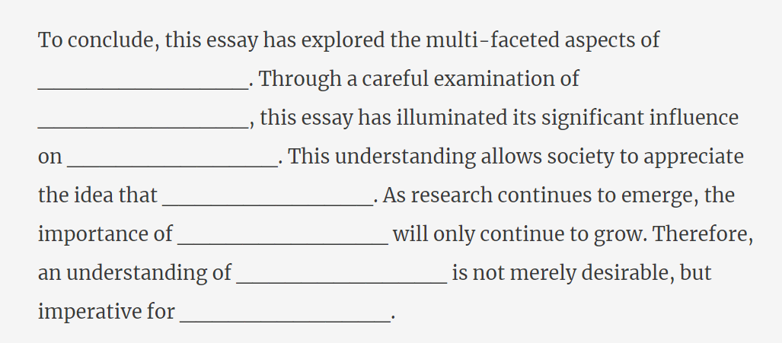

Slide 5
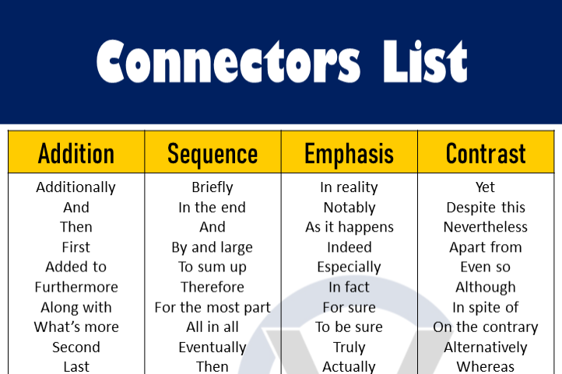

Slide 6
Use the proper connector for the following sentences:
……….. using English language is fundamental at teaching for
different reasons. ………… it is a universal language that is spoken
by third of the population of the world. ………… it is the language
of technology and science…………….lots of foreign universities
teach diverse courses in English.
……………….. English should be given more attention by
scholars as well as learners. ………..its significance is shown in
different aspects of our life. I,………….. that English is not less
than any other foreign language for all the considerations listed
above.

Slide 7
Thank you

