Slide 1
Writing Descriptive Essays

Slide 2
What, exactly, is a Descriptive Essay?
A descriptive essay is simply an essay that describes something or someone by appealing to the reader’s senses: sight, sound, touch, smell, and taste.

Slide 3
Steps to writing an effective Descriptive Essay:
1. Select a subject - Observation is the key to writing a good description. For example, if you are writing about a place, go there and take notes on the sights, sounds, and smells. A descriptive essay paints a picture for the reader, using descriptive devices and the senses.

Slide 4
Create a thesis statement – A thesis statement is simply a sentence that tells the reader what you are going to be talking about throughout the entire essay
You’re thesis statement should never begin with phrases like, “I am going to be talking about. . .”

Slide 5
Since this is a descriptive essay, create a thesis that informs the reader of who or what you will be describing.
Ex: “My bedroom is an ocean sanctuary”
Ex: “My family vacation to Disney World was a magical week of fun, laughter, and sun-filled happiness.

Slide 6
Select dominant details
Make sure you are only writing about things that specifically support your thesis.
For example, if your thesis statement is talking about your sun-filled trip to the beach, don’t bore the reader with meaningless details about your swimsuit. . . You should be describing the beach itself, and perhaps some of the events that took place there (e.g. building a sandcastle, boogie-boarding, parasailing, etc.)

Slide 7
Use descriptive words – do not use vague words or generalities (such as good, nice, bad, or even beautiful).
Think about it. . . Which sounds better?
“I ate a good dinner.”
Or
“I devoured a steaming hot, cheese-filled pepperoni pizza for dinner.”
See the difference?

Slide 8
Provide sensory detail
Smells that are in the air (the aroma of freshly brewed coffee)
Sounds (traffic, honking horns, waves crashing)
Sights (“The sun scattered tiny diamonds across dew-covered grass as it peeked out from beyond the horizon.”)
Touch (“The texture of the adobe hut’s walls resembled coarse sandpaper.”)
- Taste: sweet, sour, salty, bitter, tart (“Giant goose bumps formed on my tongue when I accidently bit into a sliver of lemon.”)

Slide 9
6. Draw a logical conclusion - The conclusion may also use descriptive words; however, make certain the conclusion is logical and relevant.

Slide 10
Now let’s practice!
On a blank sheet of paper, look at the following images.
Write down things you might hear, see, taste, smell, or feel/touch if you were “in” these pictures
After you have compiled a brief list of sensory details, write a descriptive sentence about each picture.

Slide 11


Slide 12
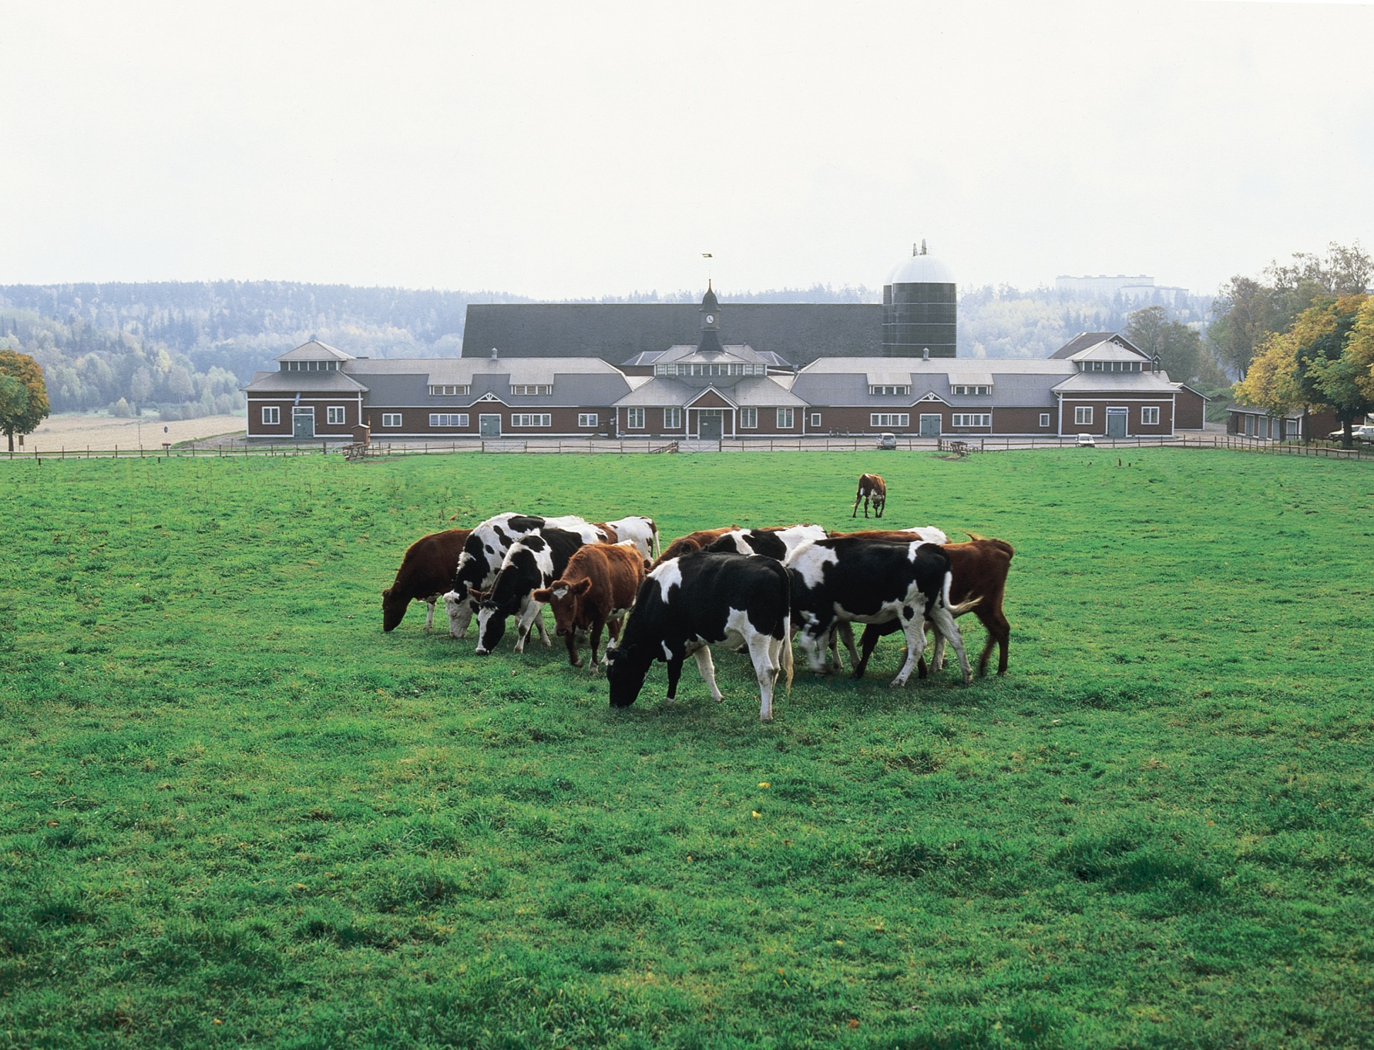

Slide 13


Slide 14


