Slide 1
WILLIAM SHAKESPEARE
The world’s greatest playwright

Slide 2
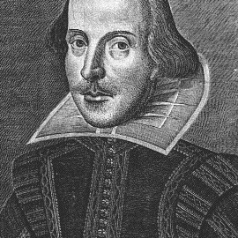
WILLIAM SHAKESPEARE
1564 -1616
37 plays
154 sonnets

Slide 3
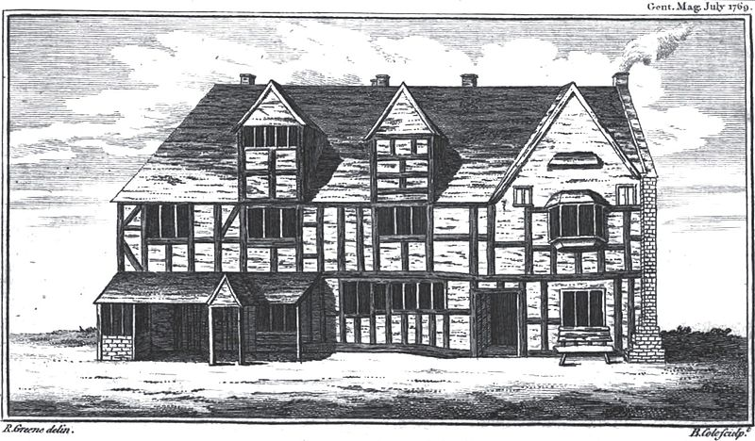
Born in 1564 in Stratford-upon-Avon

Slide 4

Shakespearian theatre

Slide 5
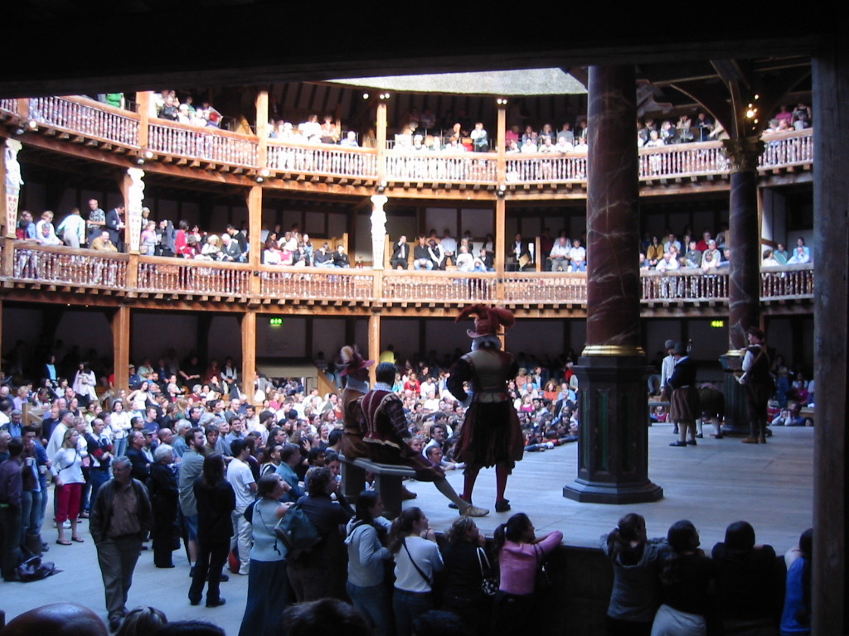

Slide 6
Shakespeare’s genres
Comedies
Histories
Tragedies

Slide 7

Romeo and juliet
The Tragedy

Slide 8
Romeo and Juliet was written by William Shakespeare in 1595

Slide 9
introduction
Romeo and Juliet is one of Shakespeare’s best known works
It is a tragic love story of the doomed love affair between two teenagers from 2 feuding Italian families

Slide 10
Prologue
The setting is Verona, Italy and it is the story of two wealthy families. Even though the families hate each other, their children fall in love. Their love meets many obstacles and because of a misunderstanding, they die for love. Their death brings the two families together and mends the feud.

Slide 11
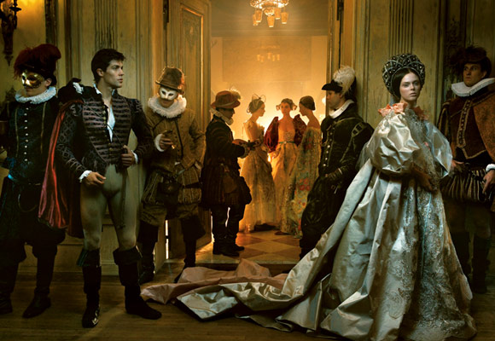
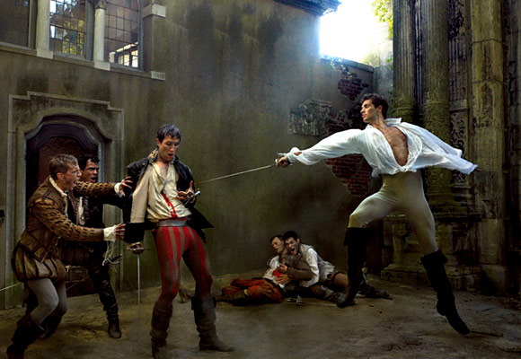
Themes in The Tragedy of Romeo and Juliet
Love
Fate
Hate

Slide 12
themes
LOVE
HATE
DEATH
MARRIAGE
RELIGION
FAMILY

Slide 13
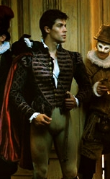
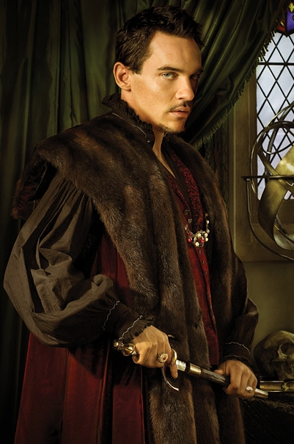

Characters
Lord and Lady Montague are Romeo’s parents. They are a noble family, and one of the richest and most powerful families in Verona’s society.
Romeo’s parents
Lord and Lady Montague
Romeo Montague
Mercutio Romeo’s friend

Slide 14

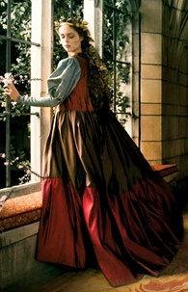
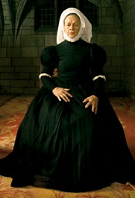
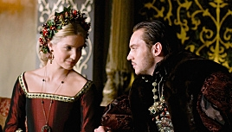
Lord and Lady Capulet are Juliet’s parents. They too are a noble family, which means they were wealthy and important in Verona’s society. The Capulet are ruthless and like things to be done their way
Juliet Capulet
Tybalt
Juliet’s Cousin
Nurse
Juliet’s attendant
Juliet’s parents
Lord and Lady Capulet

Slide 15
Act i
Shakespeare establishes an on-going feud between the Montague and Capulet family
Juliet’s father decides that even though Juliet is only 13 it is time to find her a husband
Romeo (a Montague) and Juliet (a Capulet) meet and fall in love

Slide 16
Act ii
Capulets challenge Romeo to a duel and Romeo’s friends fear for his safety
Friar Laurence conspires with Romeo to arrange a secret marriage
By the end of Act II… Romeo and Juliet are married!

Slide 17
Act iii
Duel between Romeo and Tybalt
Romeo kills Tybalt
Romeo is banished from Verona
Juliet’s father announces that she shall wed Paris in 3 days
Juliet seeks the advice of Friar Laurence where, unbeknownst to her, Romeo is hiding

Slide 18
Act iv
Juliet threatens to commit suicide rather than marry Paris
Friar Laurence convinces Juliet to fake her death in order to be with Romeo
Juliet follows the Friar’s plan, and her corpselike body is discovered by her nurse

Slide 19
Act v
Romeo receives word that Juliet is dead
He buys a fast-acting poison and travels to Juliet’s tomb so that he may die beside her
Romeo drinks the poison!
Juliet awakens and stabs herself to death with Romeo’s dagger
The feuding families end their feud and erect golden statues of the lovers.

Slide 20
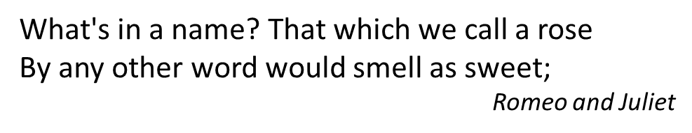
FAMOUS QUOTE

Slide 21
Shakespeare’s Themes
In today’s world many of Shakespeare’s themes still apply. People fall in and out of love, people hate each other, and people seek revenge.

Slide 22
The Nature of Things People
In the 400 years since Shakespeare wrote his plays, people have not changed much. Shakespeare wrote about humanity’s basic nature- how people interact, how people fall in love, how people express fear, anger, and doubt

Slide 23
RELEVANCE
Shakespeare’s plays remain relevant today because the situations presented still apply
Romeo and Juliet - young people still fall in love against their families’ wishes. It may not be as bloody and violent but there is still conflict

